Slide 1

PCSD Fine Arts
#pauldingfinearts
Notes:
Welcome – thank you for coming out tonight
My name is Katie Anderson, Fine Arts Coordinator for Paulding County Schools
I hope this presentation will give just a small glimpse into the wonderful world of the fine and performing arts in PCSD

Slide 2
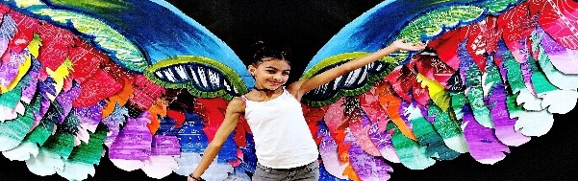
What Lifts you?
#pauldingfinearts - where amazing things happen EVeryday!
Notes:
WHAT LIFTS YOU?
In the Fine and Performing Arts, we are OUT of the box. Inspiration comes from unexpected places and Beauty is definitely in the eye of the beholder.
Our GOAL is not always the final product – most of the time, it is about the process.
In the Fine and Performing Arts – we never fully ARRIVE. We are striving every single day for more

Slide 3
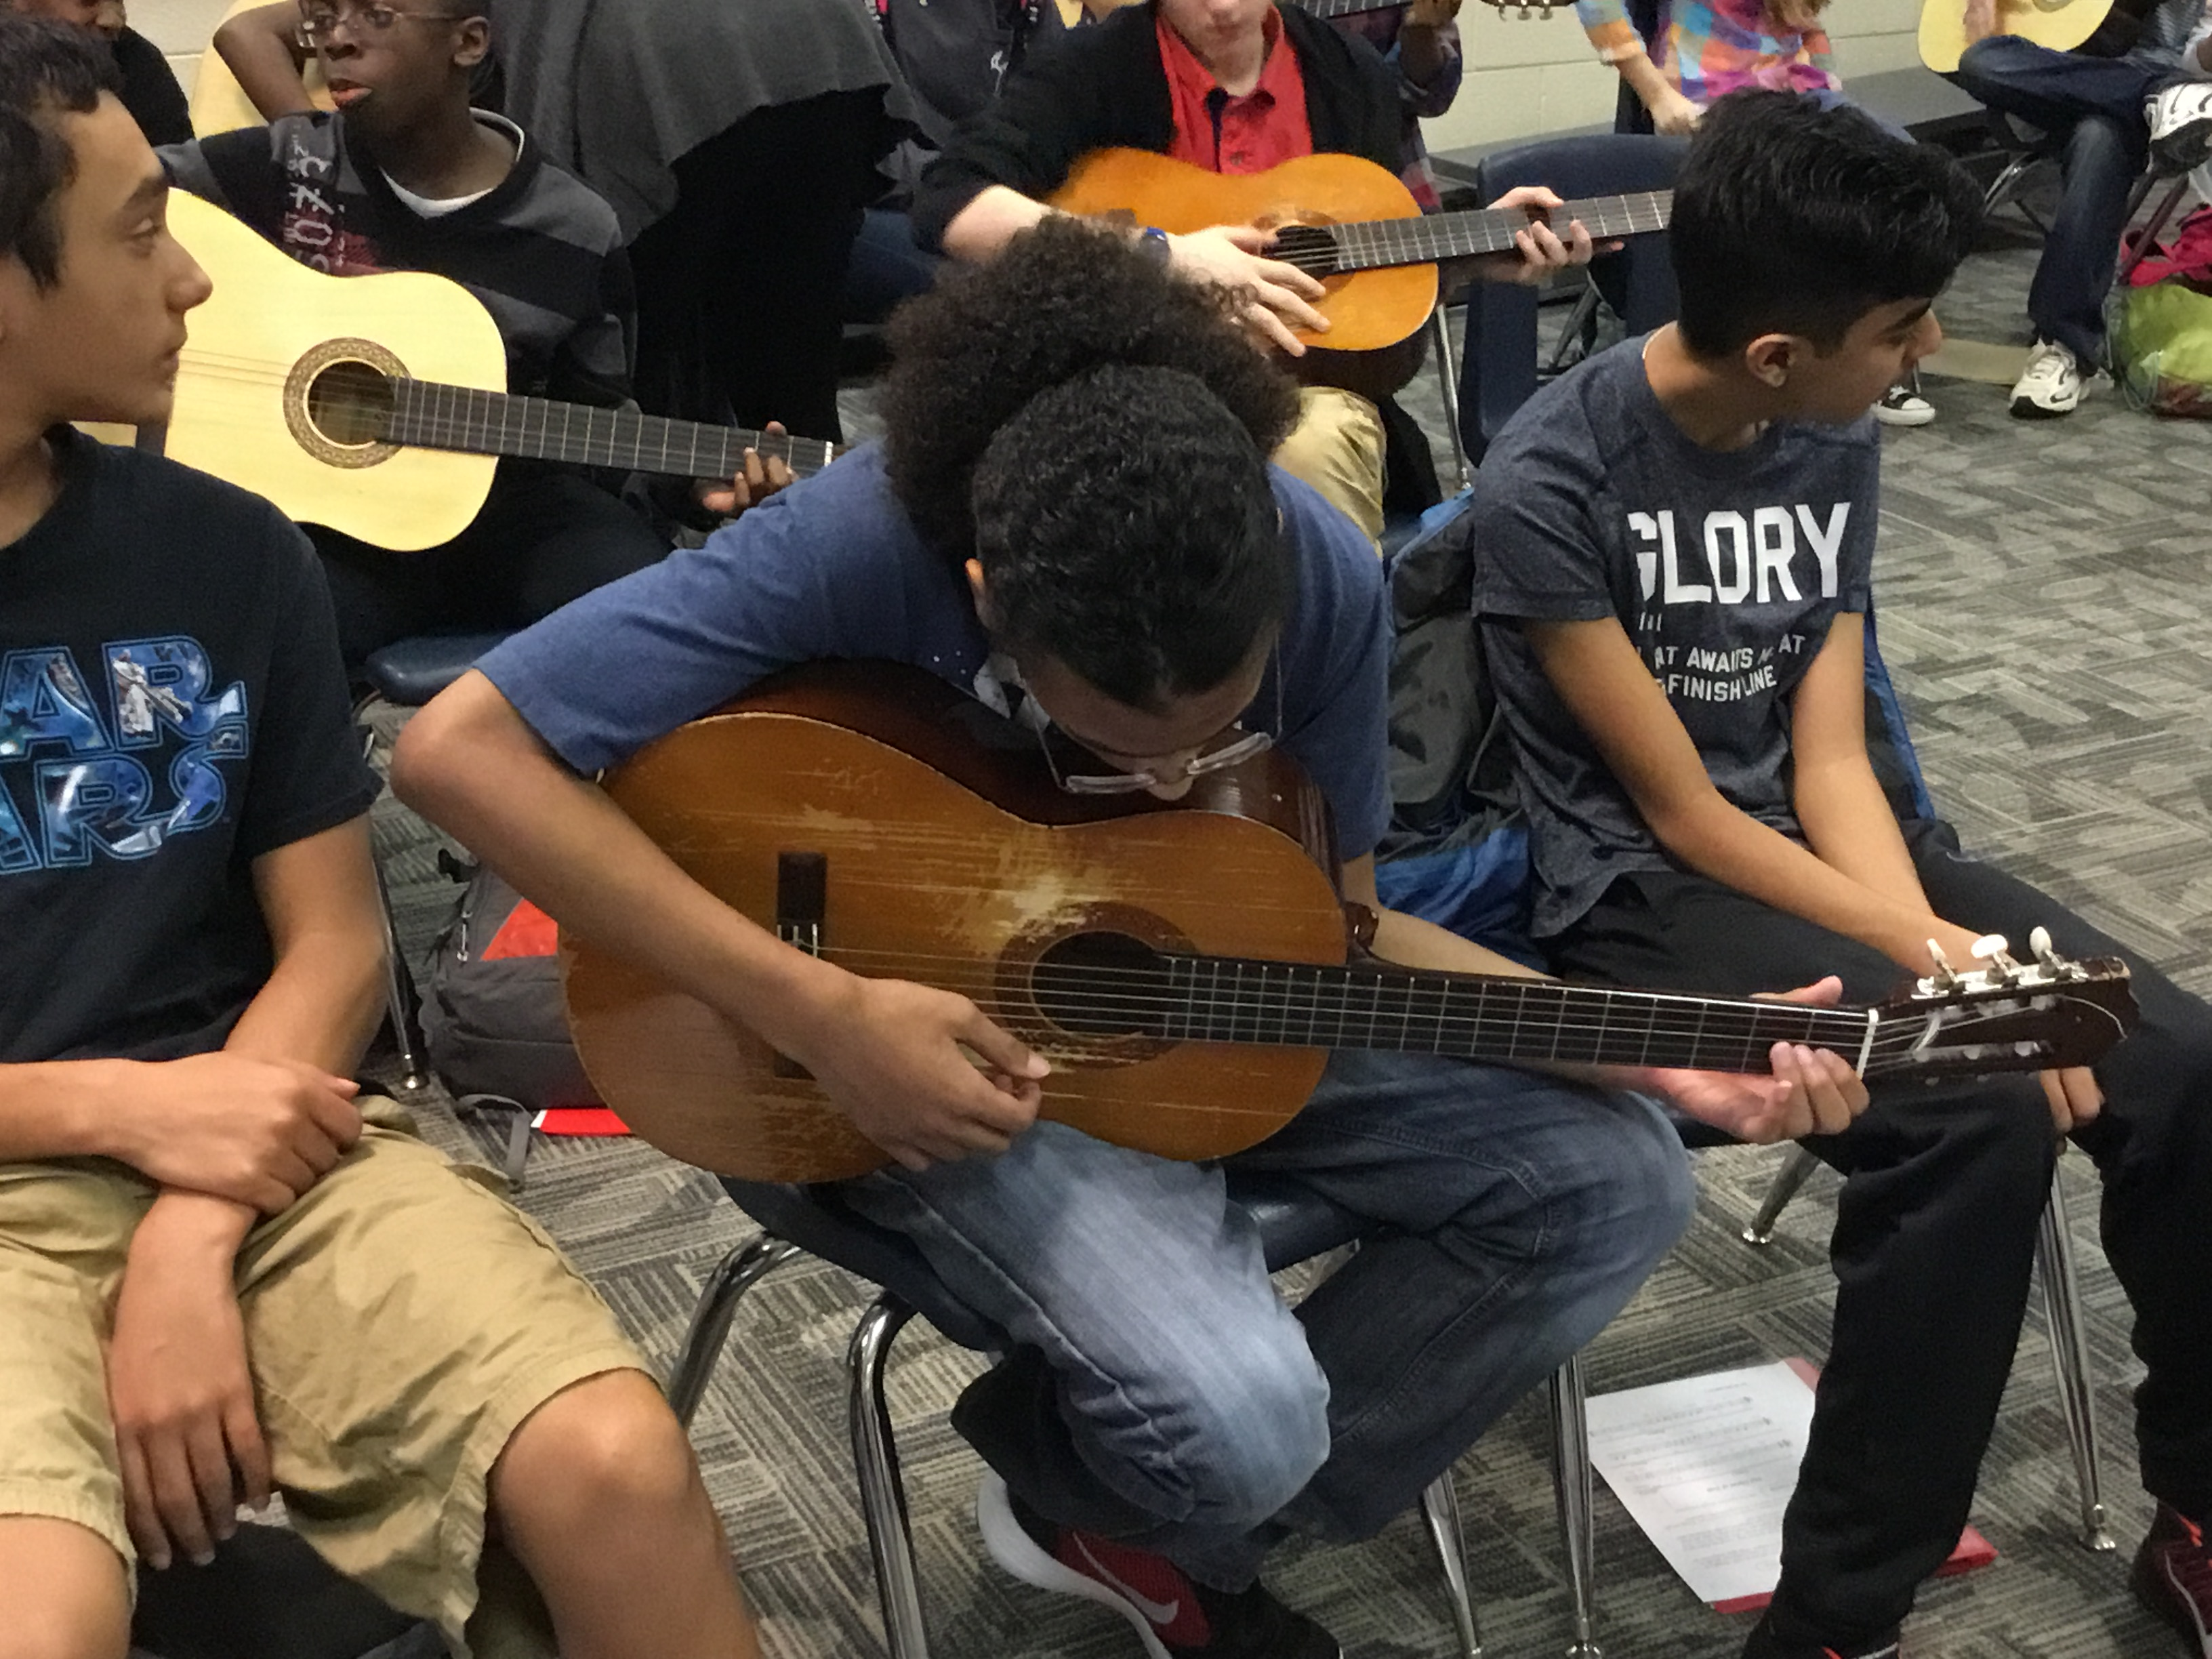
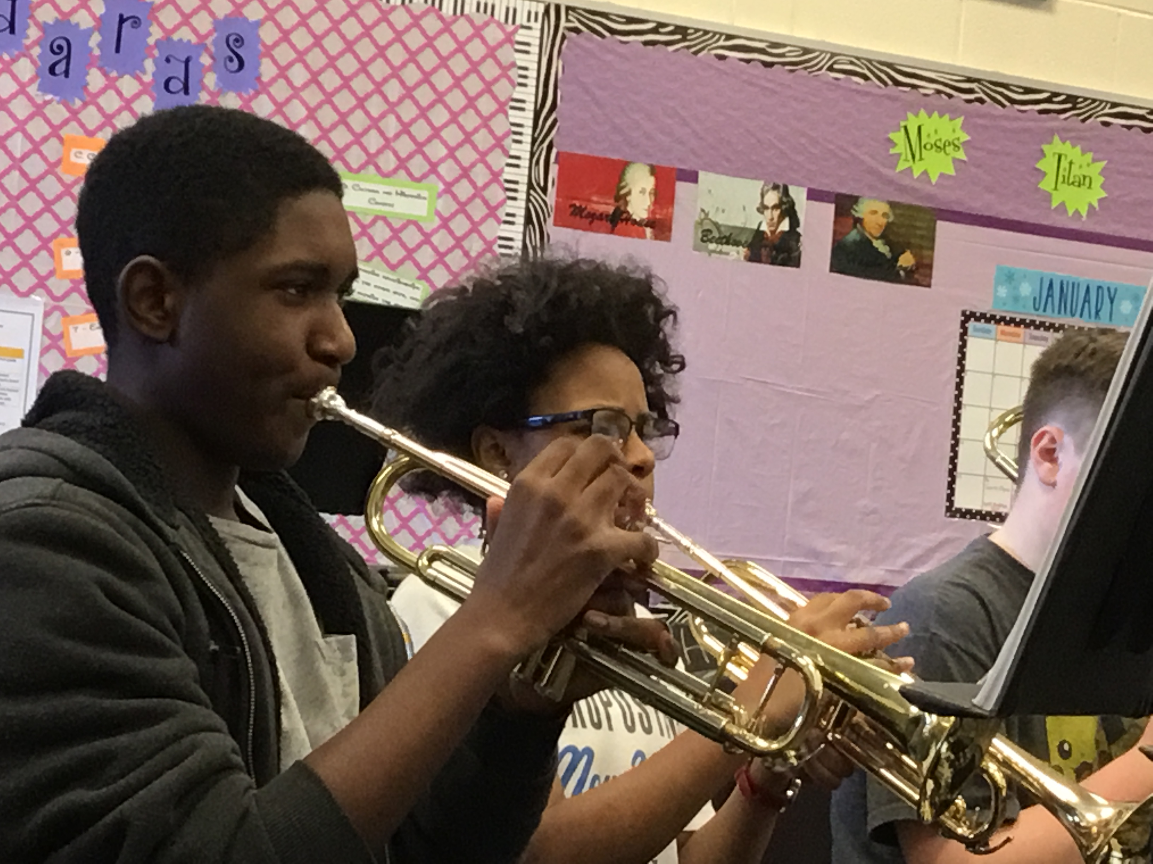
THE SOUND OF SUCCESS?
Notes:
Success is measured in multiple ways in the fine arts.
What does it SOUND like? Perhaps it is a simple strum of the very first chord in middle school guitar
Perhaps it is a slow scale from the trumpets in 2nd period, 6th Grade band.

Slide 4
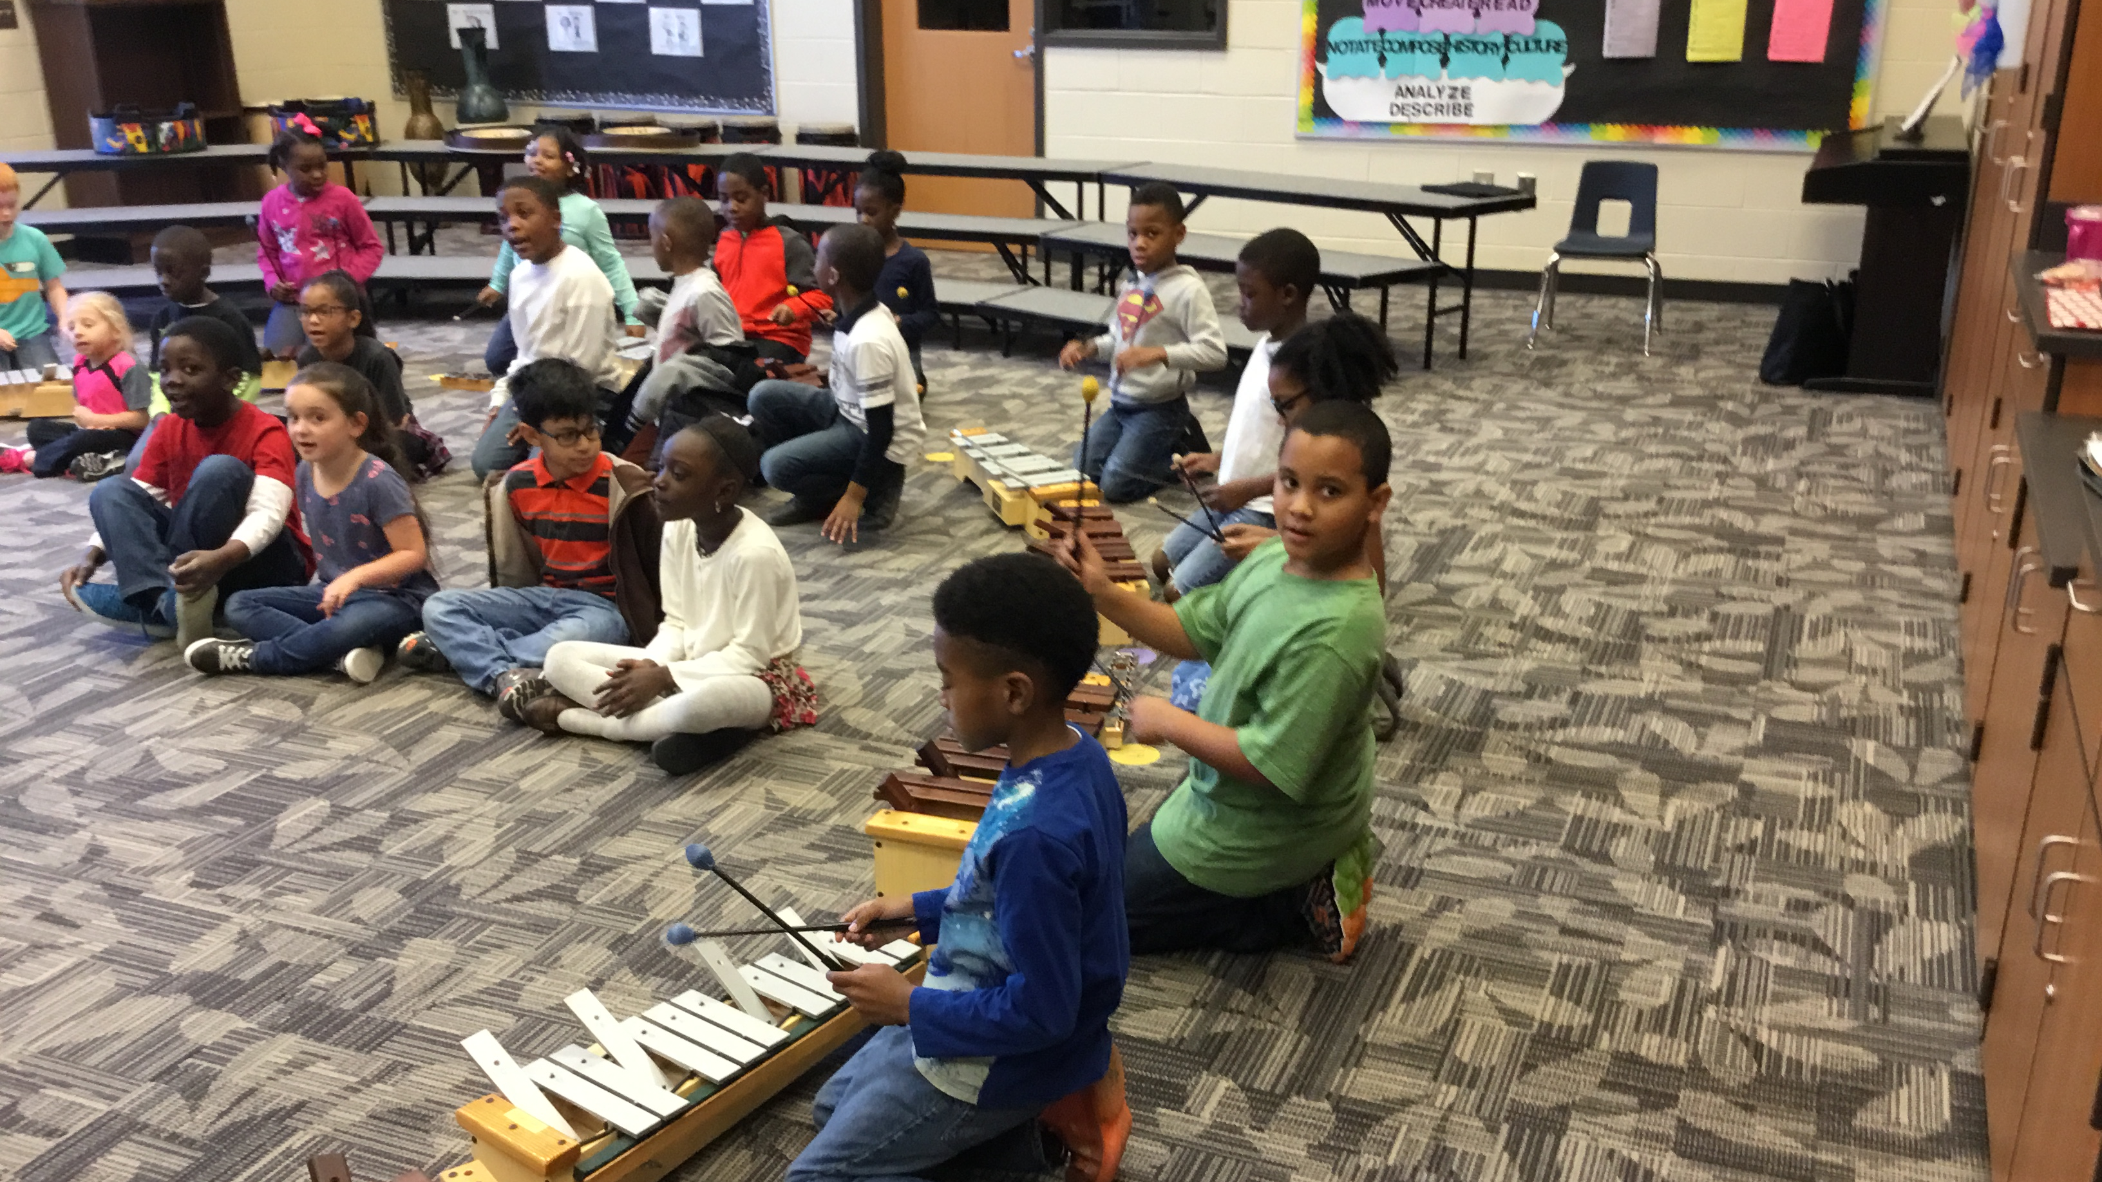
This........
Notes:
Step into any elementary music classroom in PCSD and you will find students playing instruments, dancing, and singing.....

Slide 5
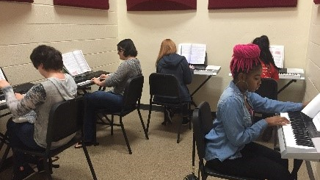
Becomes this
Notes:
Step into any middle and high school music class and you will find students playing instruments, singing, and dancing – this time, reading the notes.

Slide 6
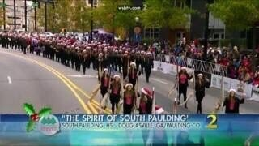
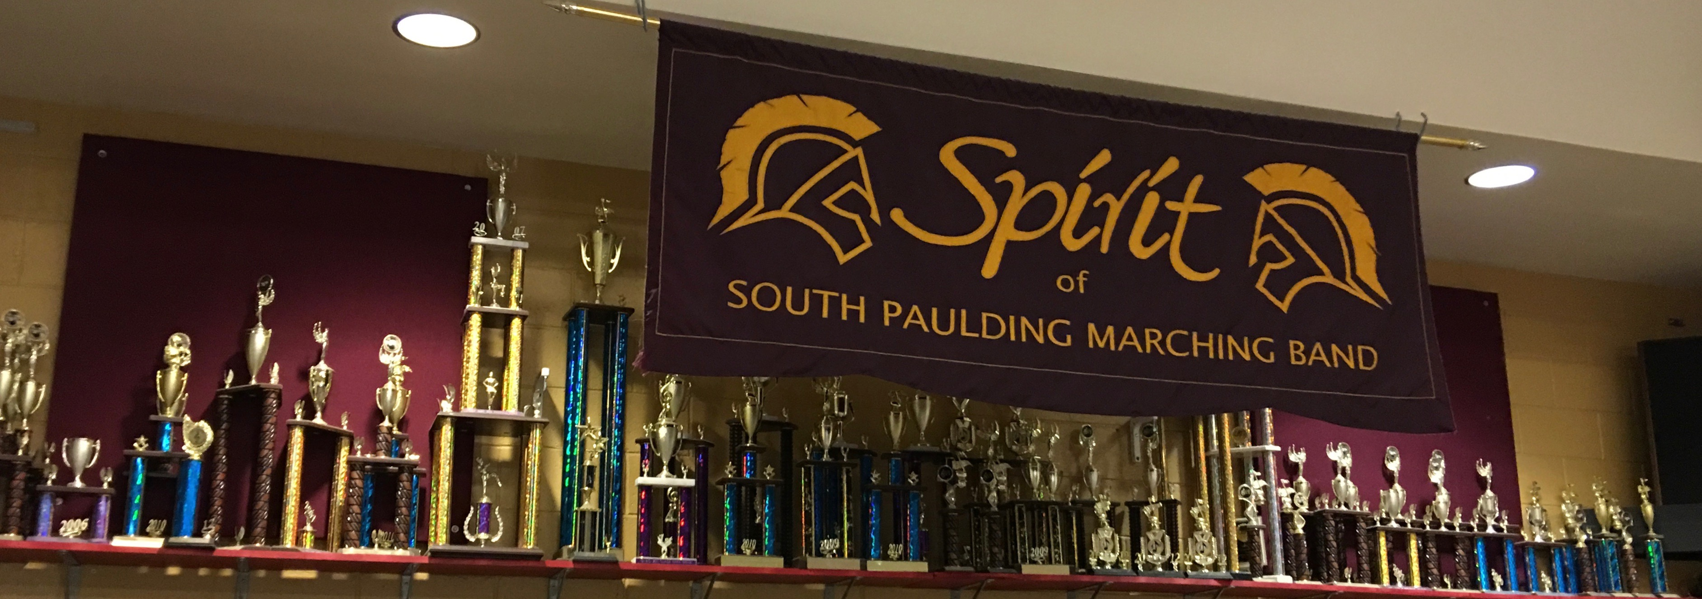
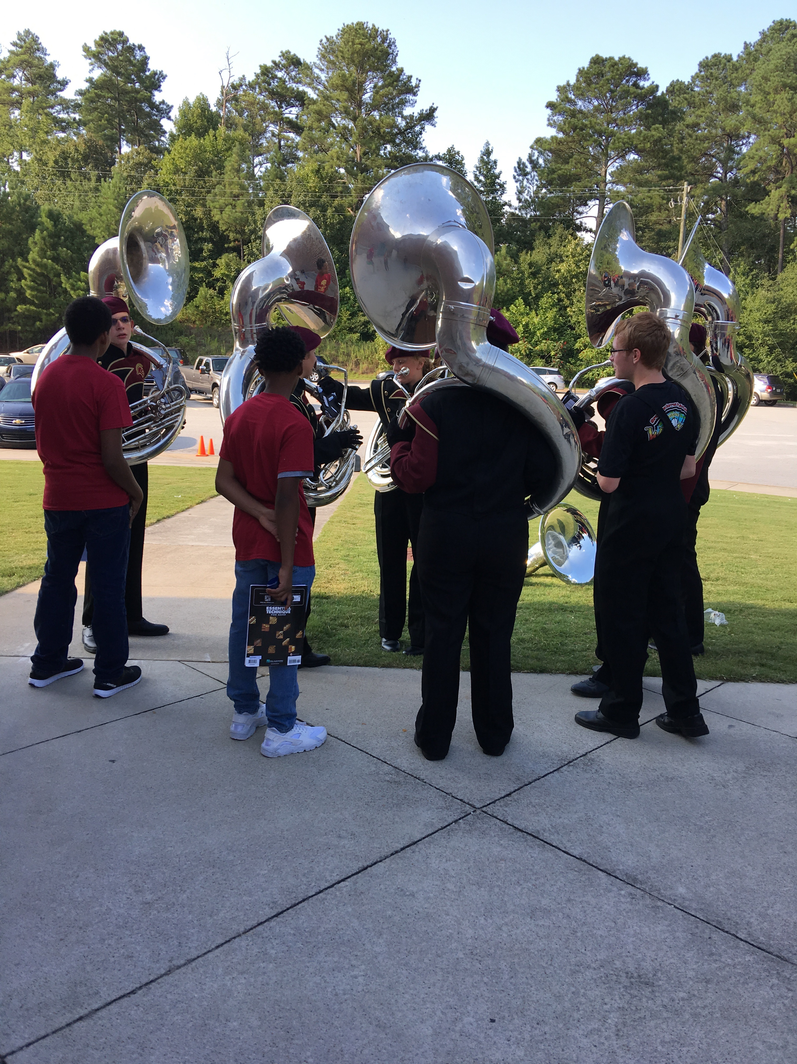
And this
Notes:
Step onto any football game at halftime and you will hear award winning performances and catch glimpses of future college music majors

Slide 7
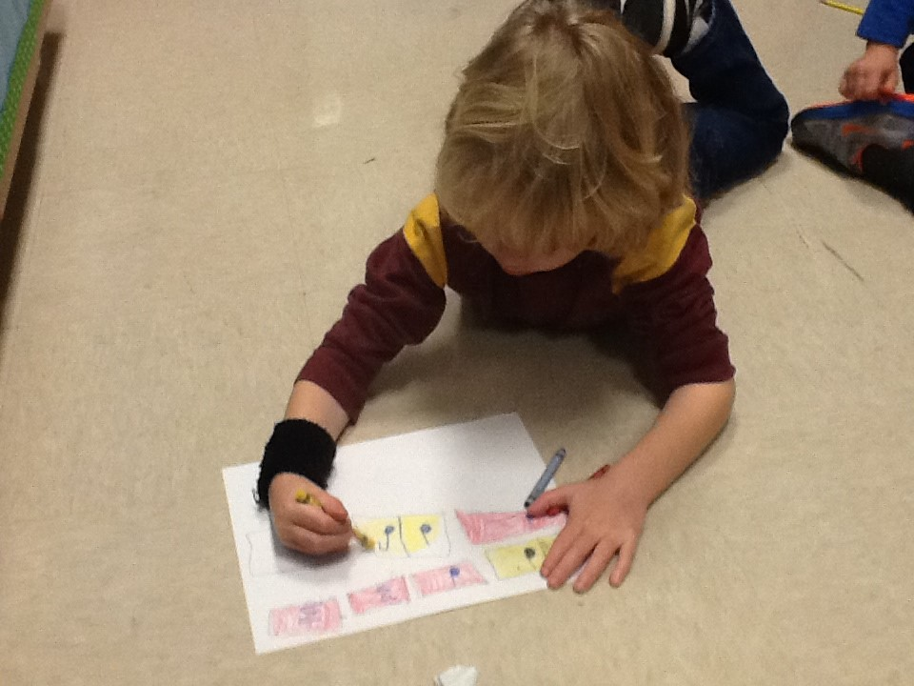
THIS.......
Notes:
In elementary music, we start with the basics so that by middle and high school....

Slide 8
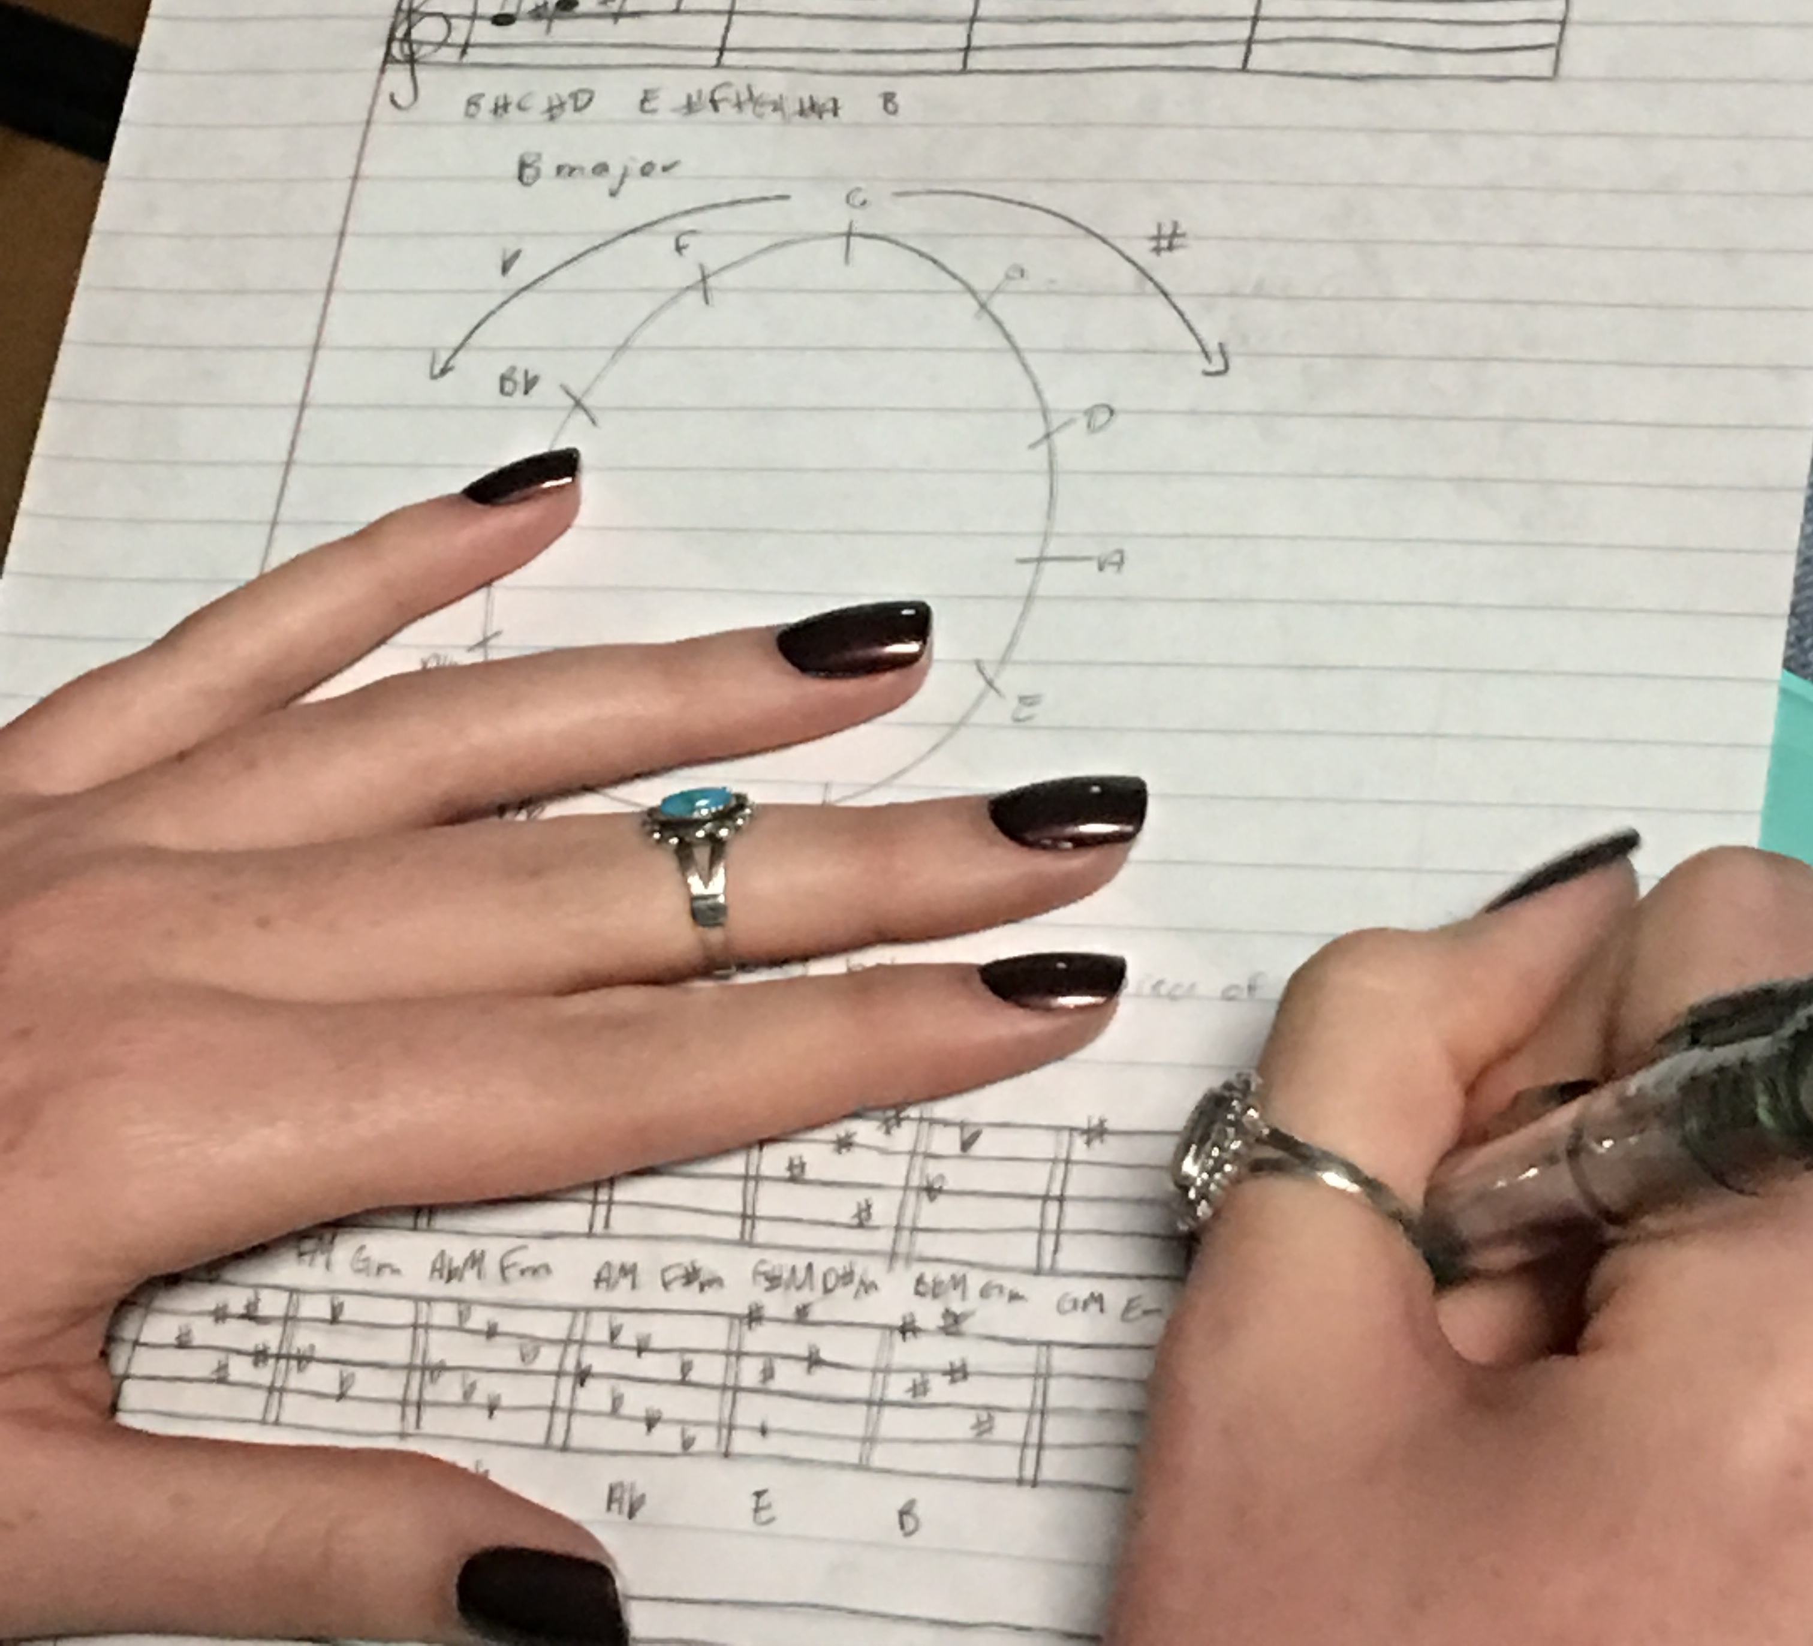
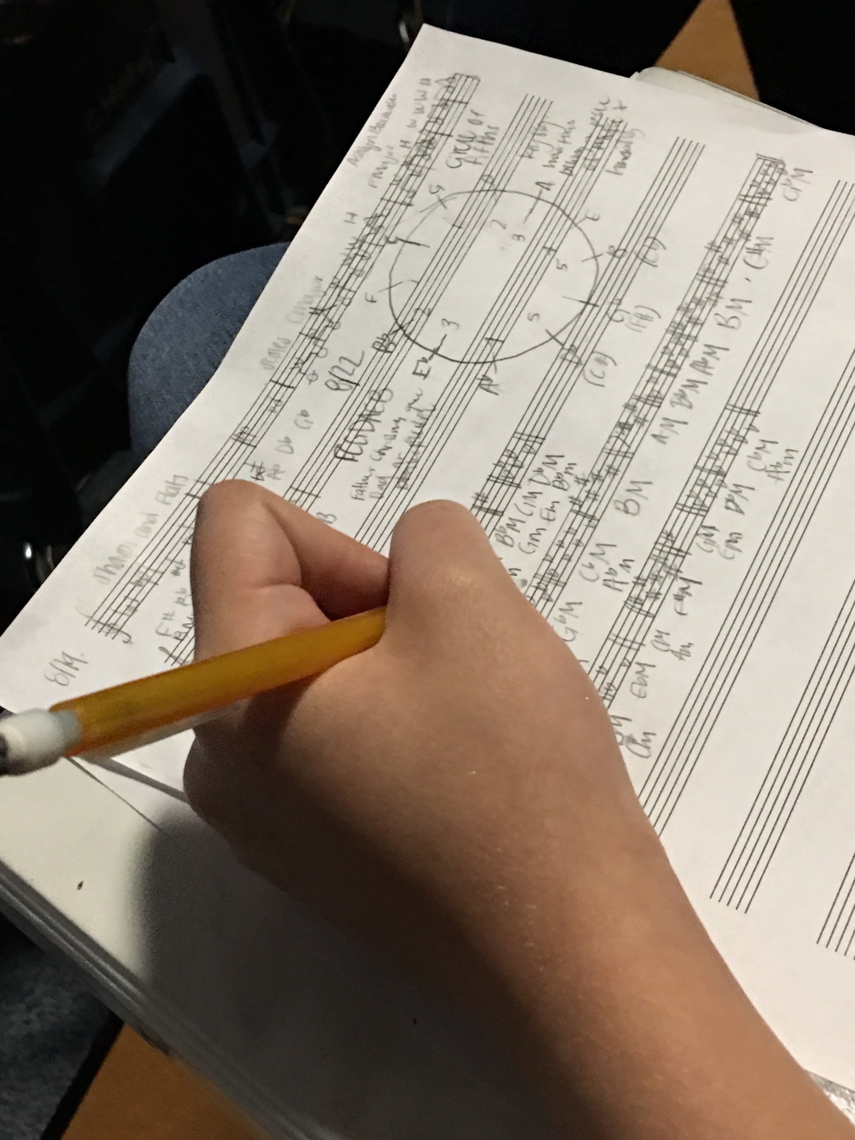
Becomes this
Notes:
…..We have serious musicians connecting the scientific and mathematical calculations necessary to compose wonderful new works!

Slide 9
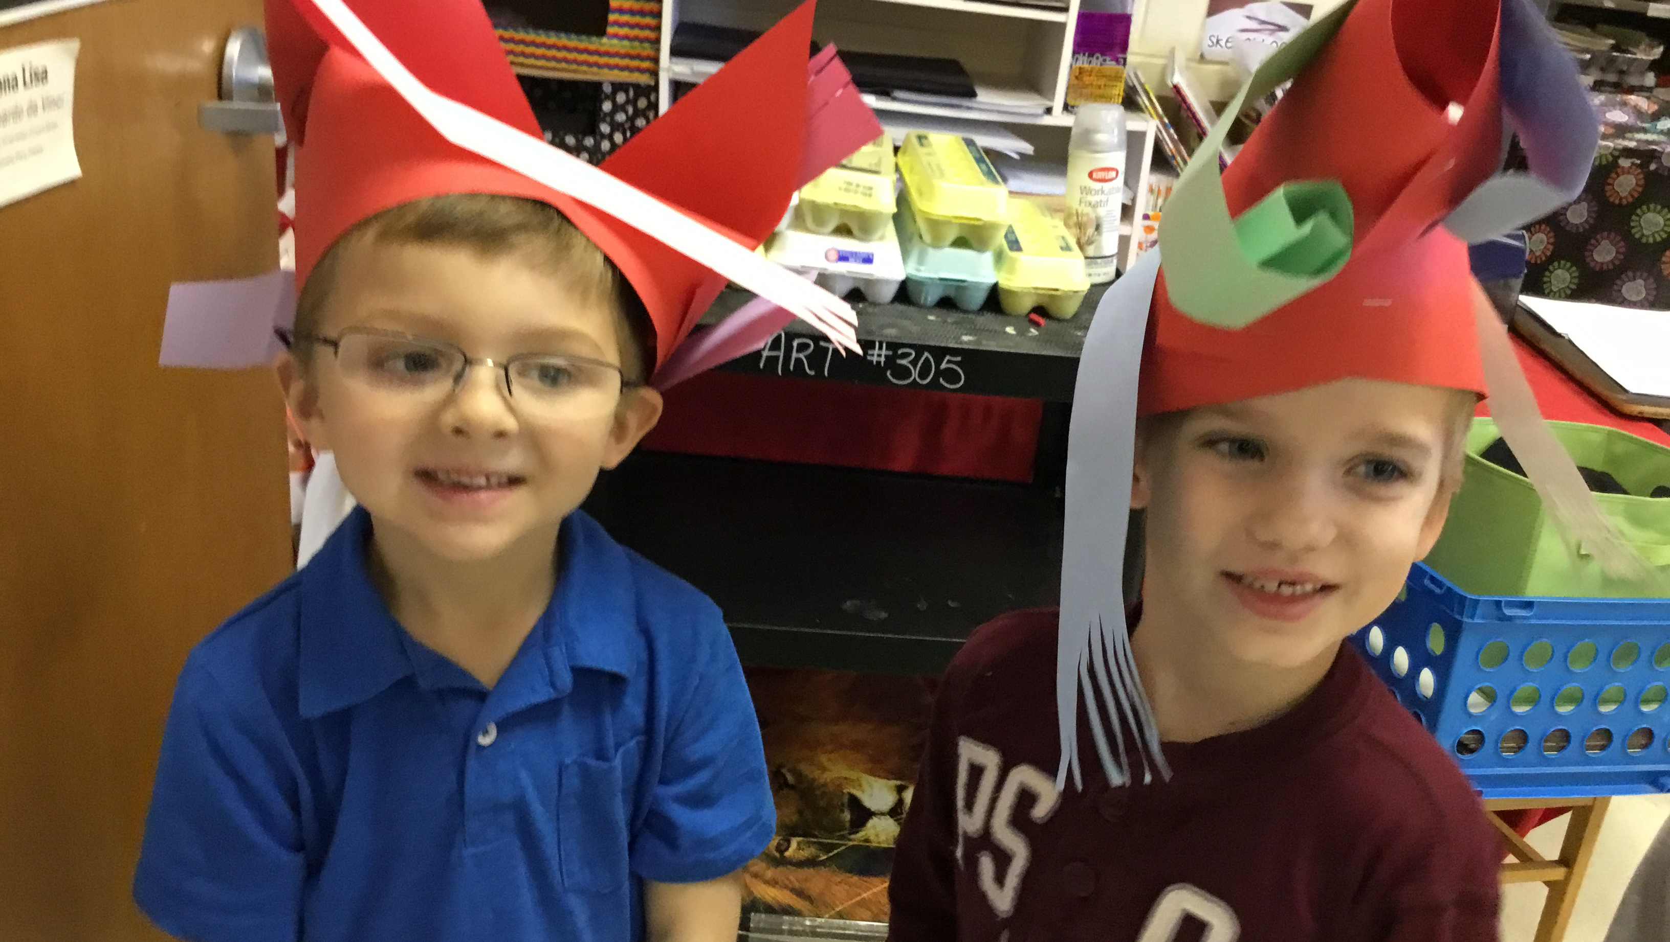
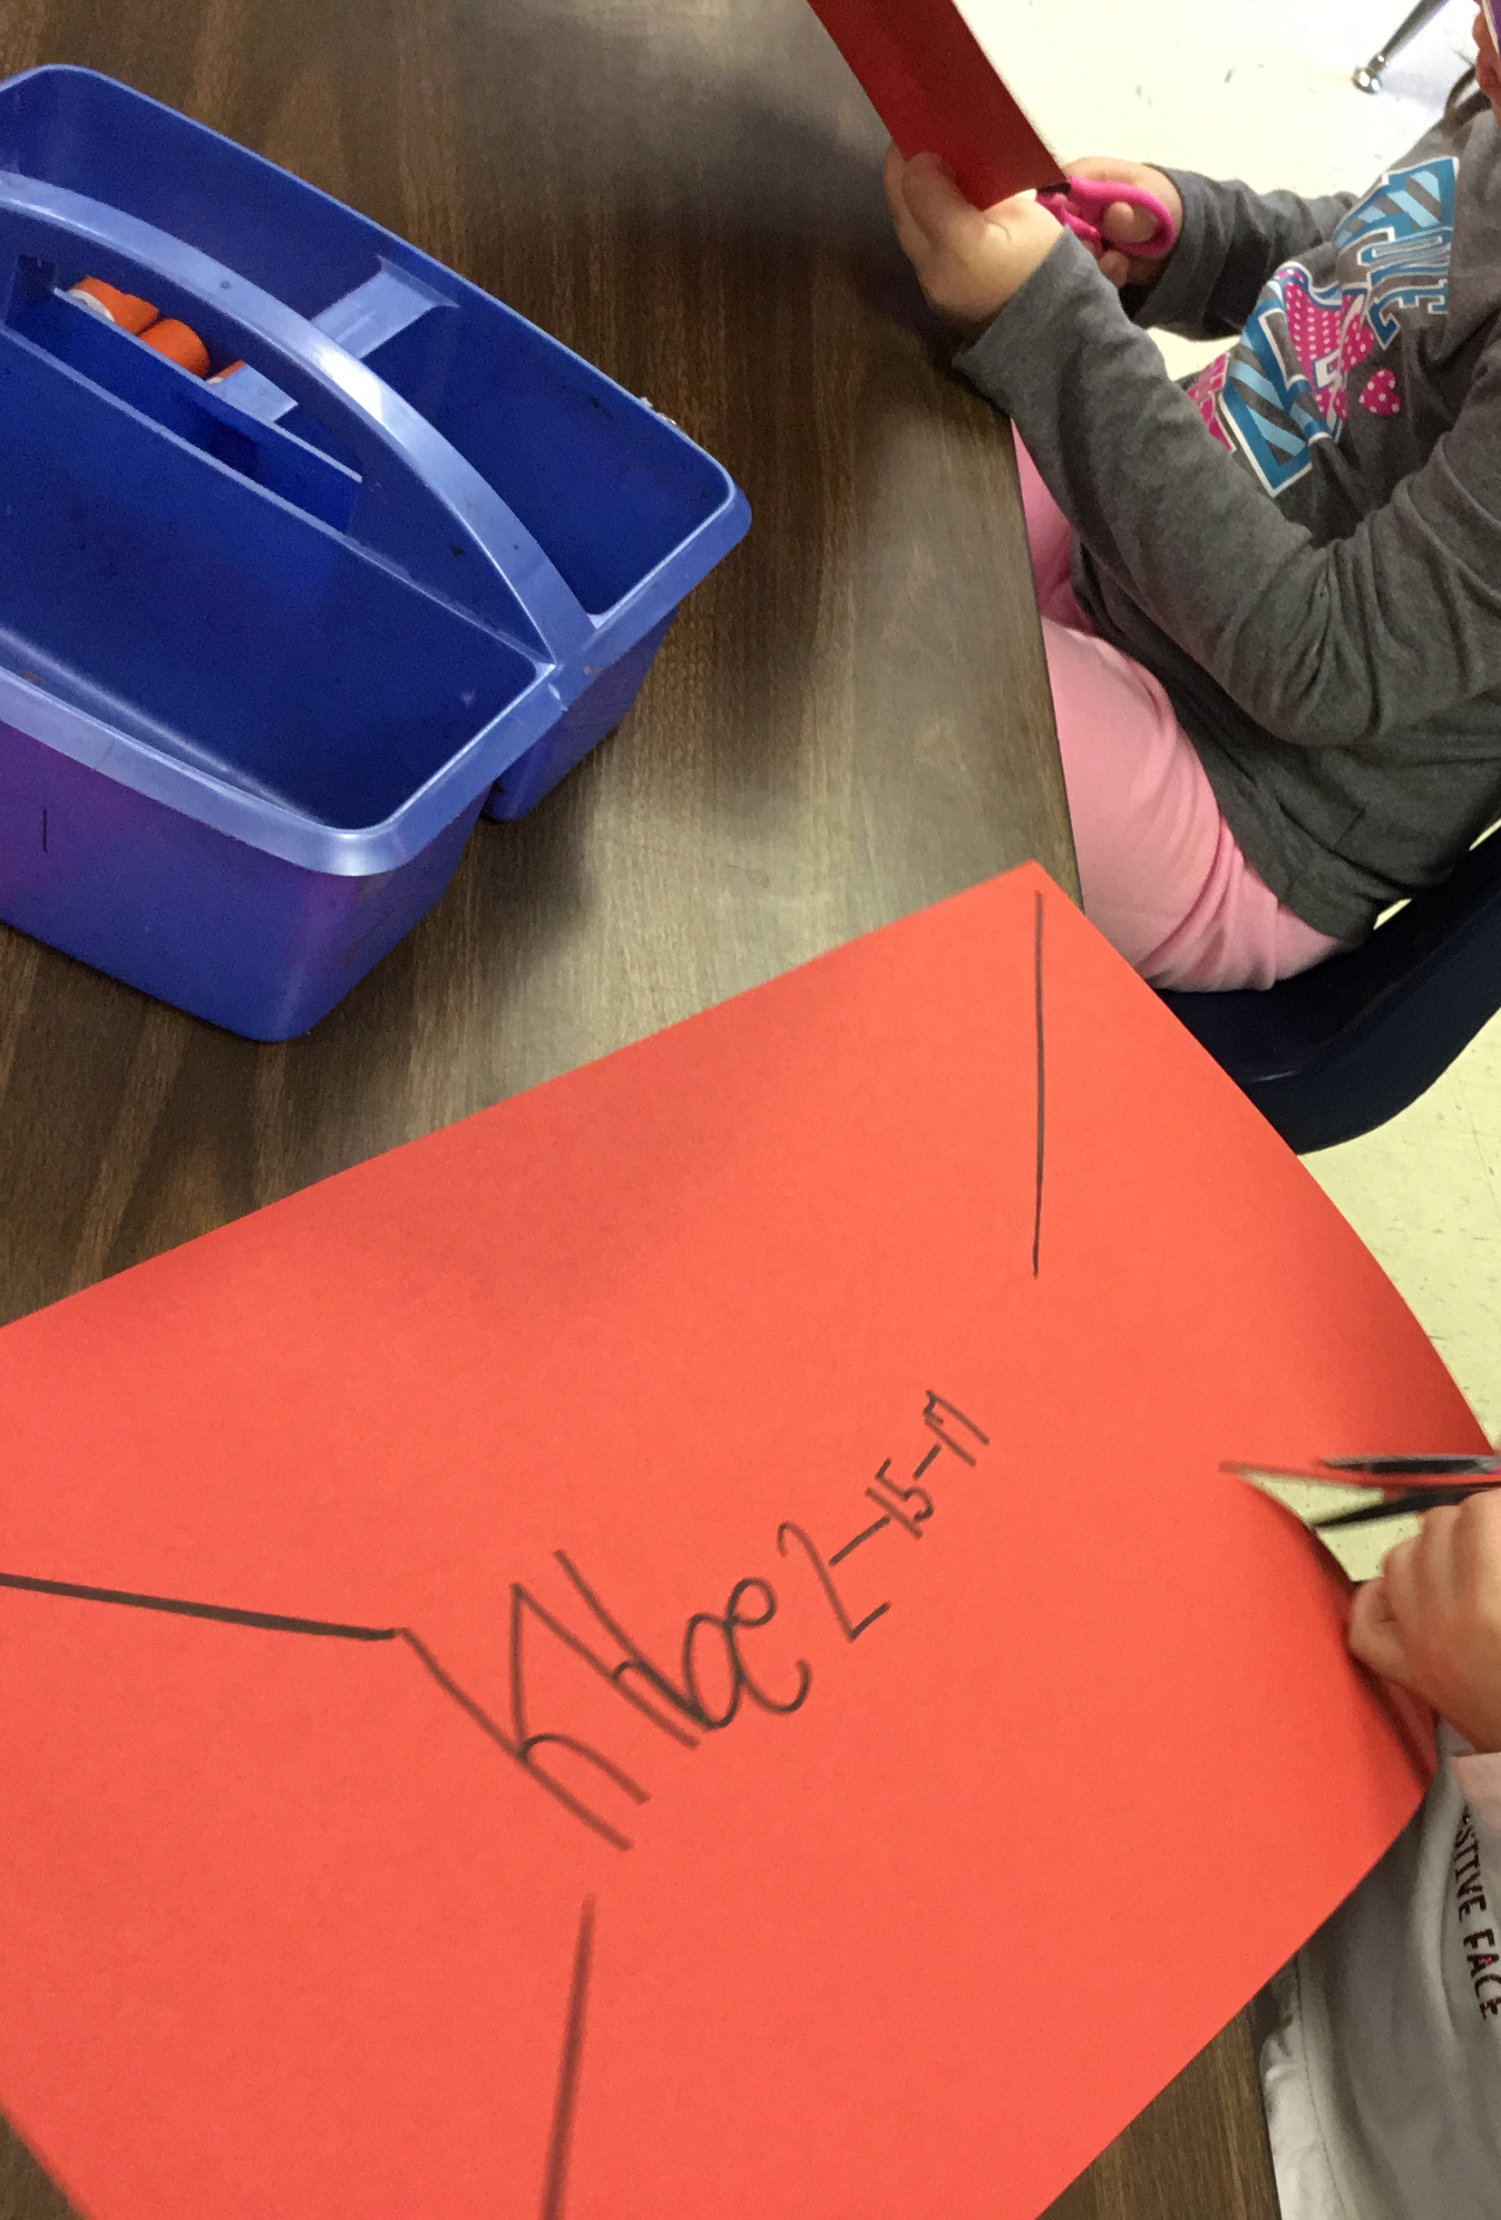
And This......
Notes:
Art is fun.....but its purpose....

Slide 10
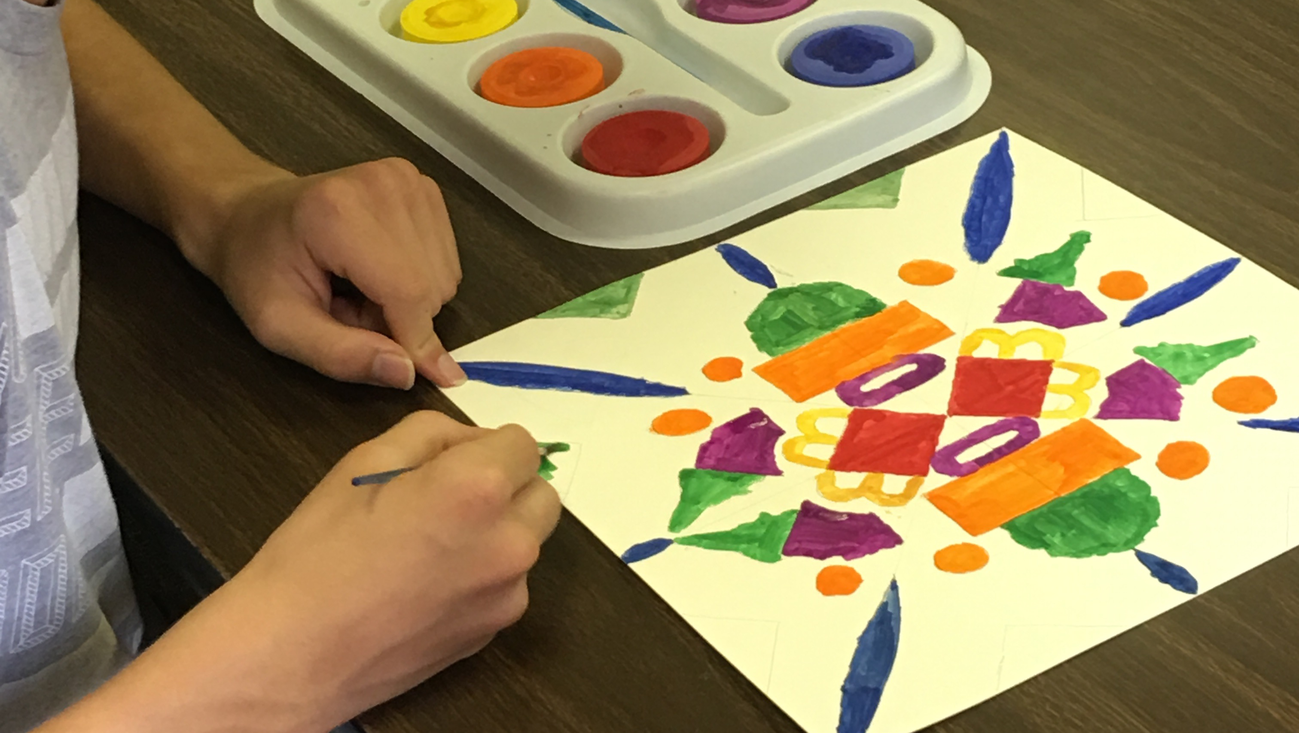
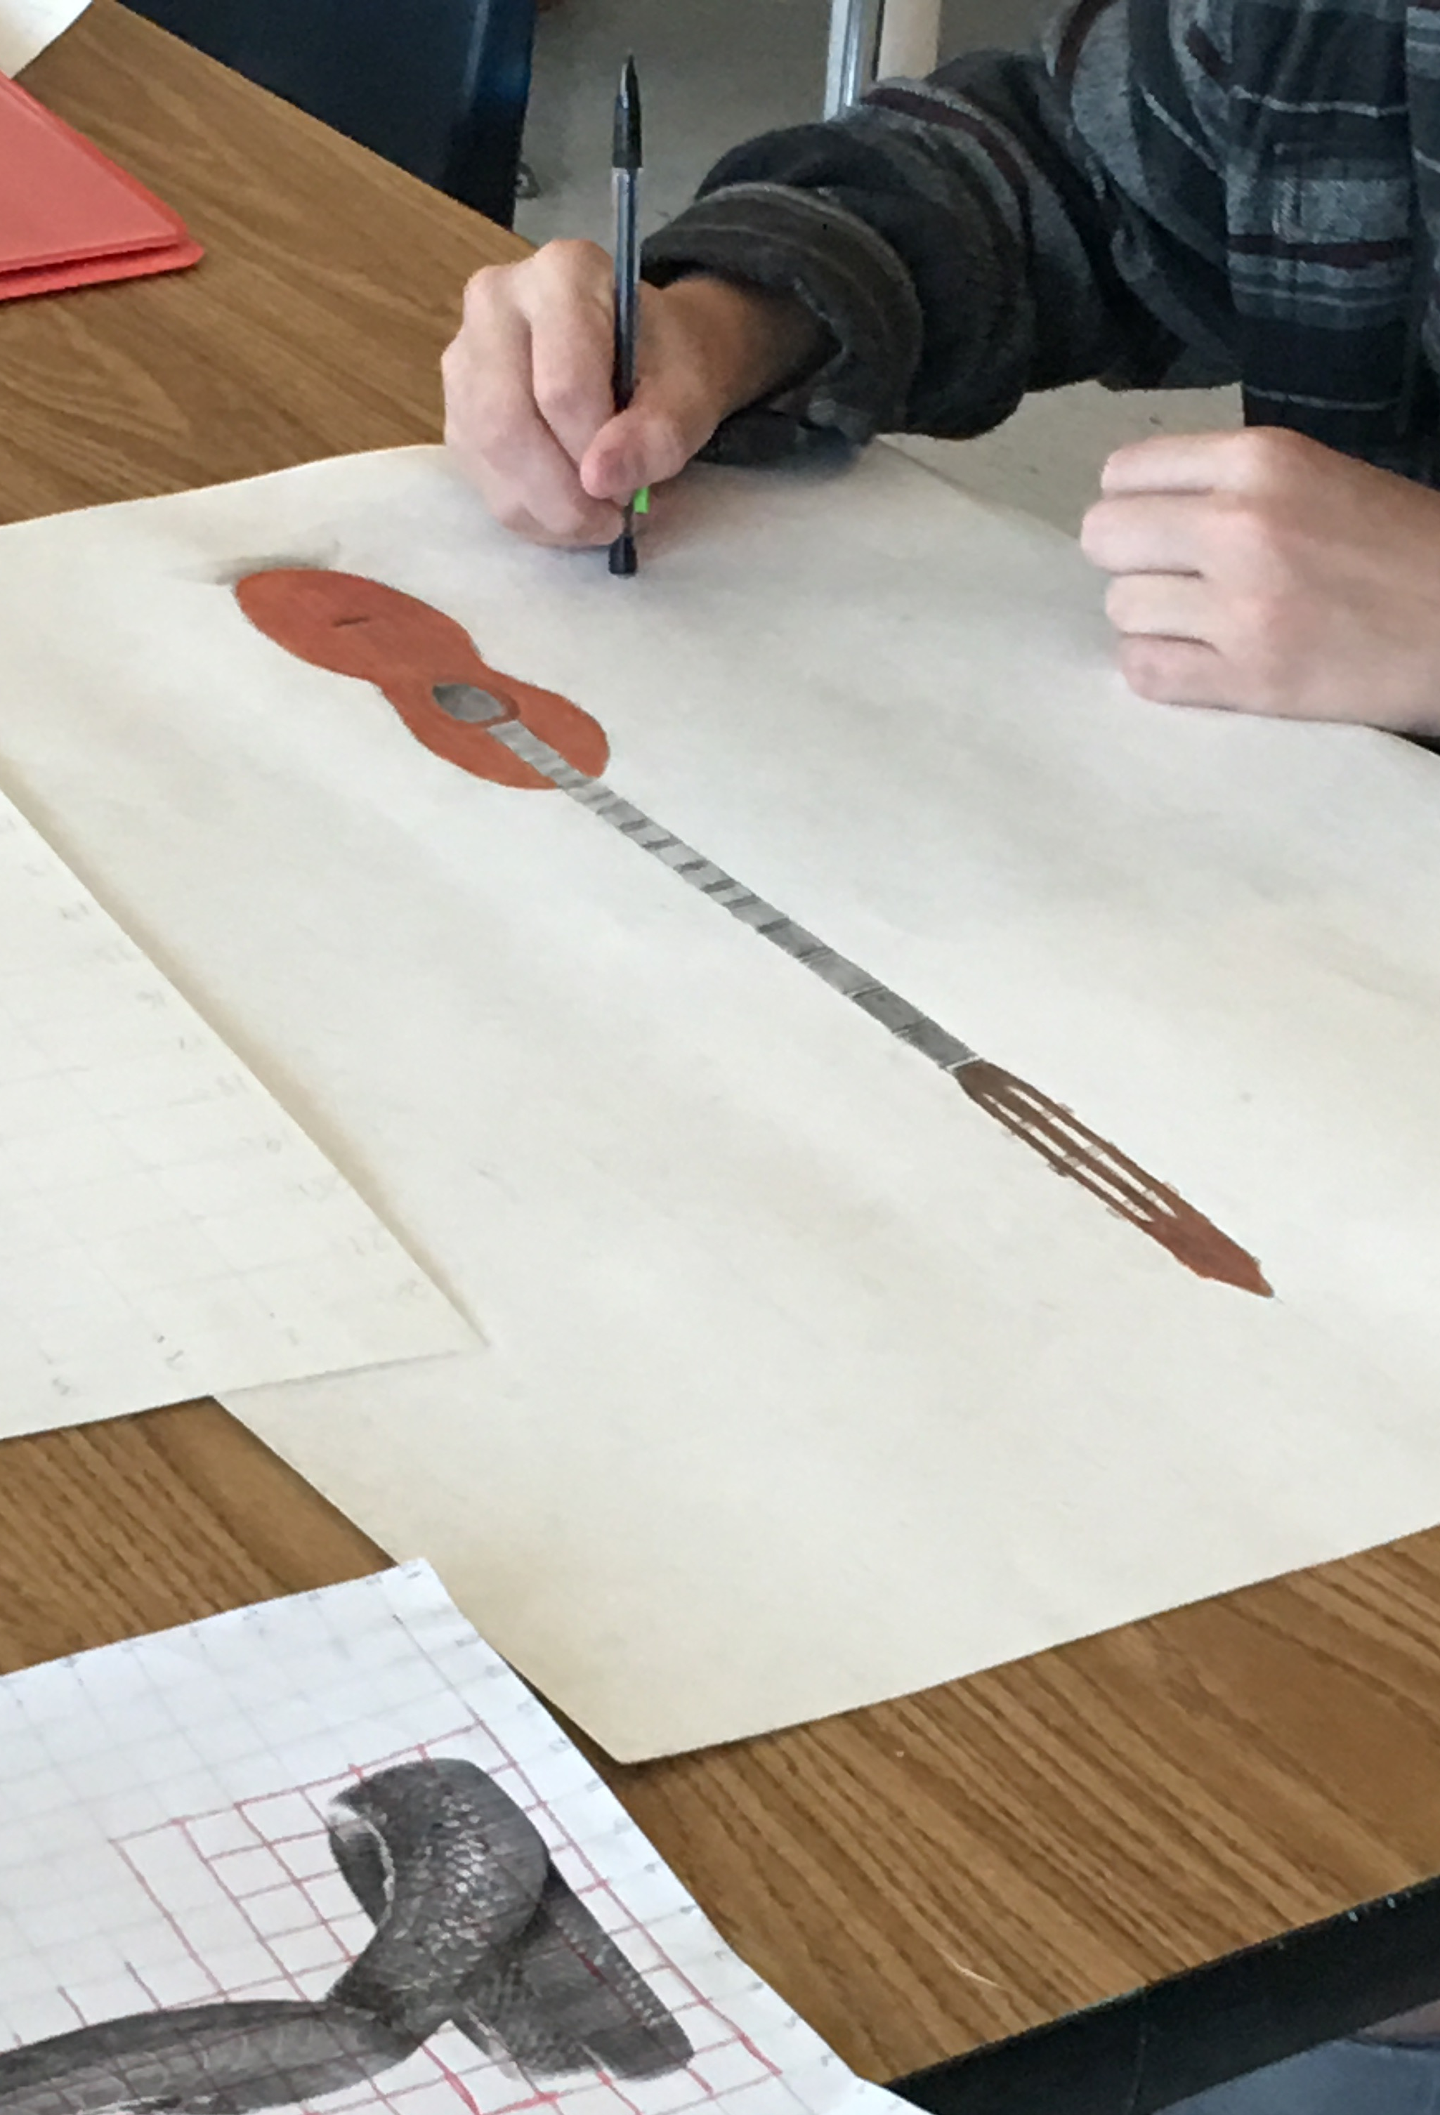
Becomes this
Notes:
Is part of a much bigger picture.
In the state of GA alone last year, the creative industries were an over $50 billion dollar business.
They no longer need something to "fall back on"

Slide 11
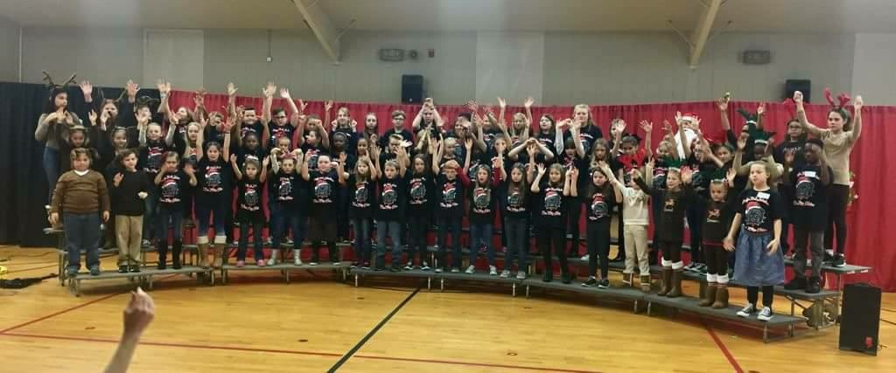
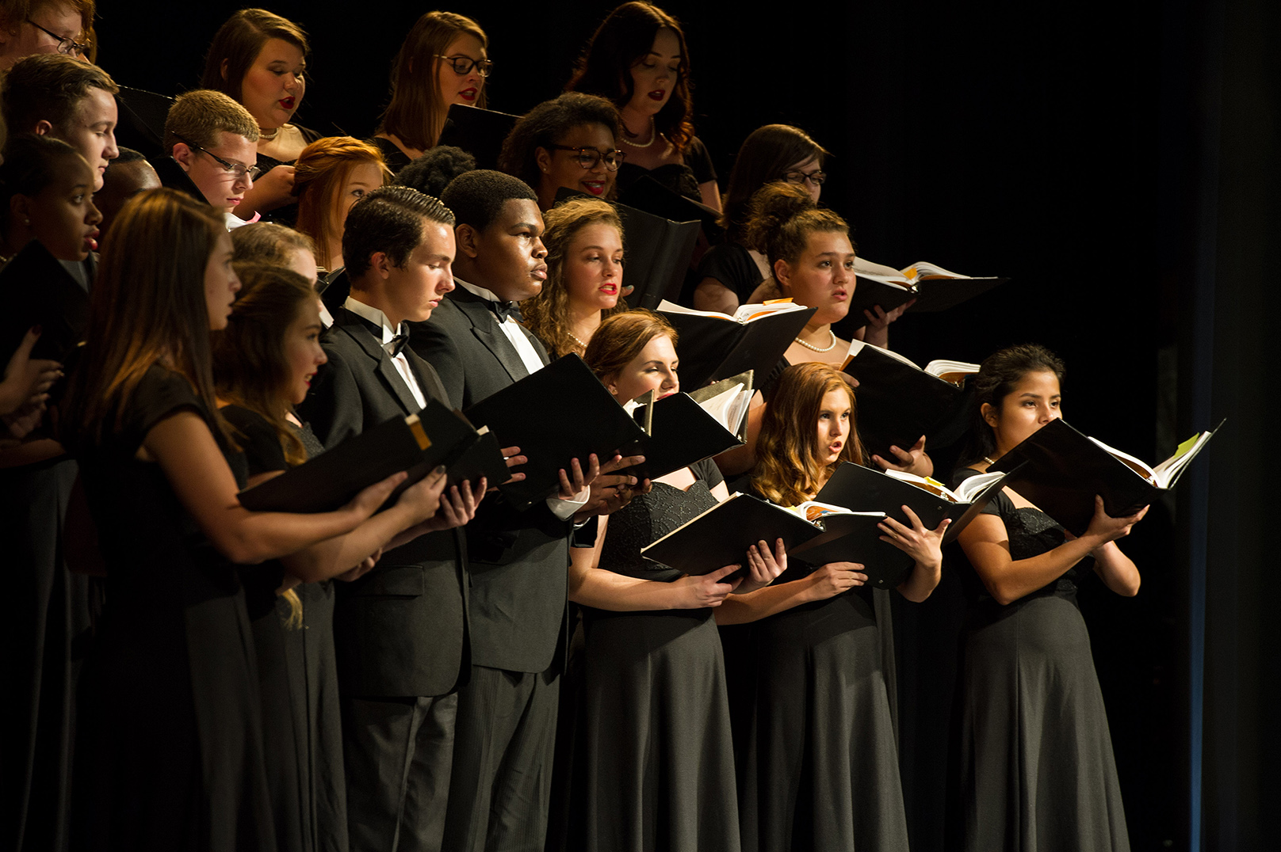
From elementary through high school
#pauldingfinearts is for every student
Notes:
Students in Elementary love to dance and sing!
This fun Never has to stop – and it can become their careers!
Transition to Shelley Patrick – to highlight how a person can keep up with all that is going on in PCSD Fine Arts with our quarterly publication

Slide 12

The State of the ARts – Quarterly Publication
October 2016 Publication
January 2017 Publication
March Special Edition – Fine Arts Day
April 2017 Publication
May 2017 Publication
Notes:
Shelley – talk about the publication.
January publication in folder – walk through gathering of info, column writers. Opportunity to build leaders throughout the county.
As a teacher, beneficial for collaboration and advocacy. Opportunity to see what's going on in other classrooms which can lead to opening conversations for collaboration. Also an opportunity to share what your students are doing and know that it is not just being seen in your school or community, but throughout the entire county.
Publications are printed each quarter and given to all fine arts teachers and administrators within the county for distribution via email. It is also placed on the PCSD website – where archived editions can be found on the fine arts page. Links are also placed on social media through Paulding Fine Arts as well as teachers who choose to share on their own school's social media accounts.

Slide 13
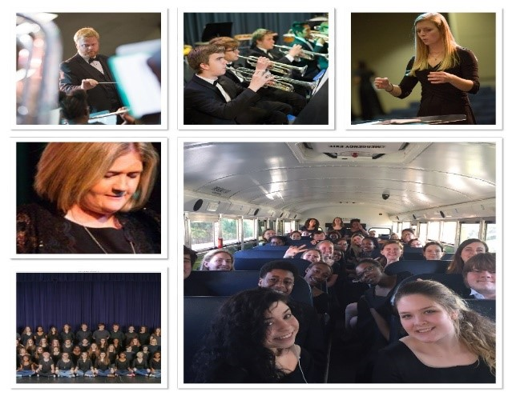
Bands in PCSD
Notes:
Katie
Our Instrumental program is very strong and active!
Band Directors and Assistants are all involved tonight with their groups rehearsing (literally, it is band camp and they are going until 8 or 9 tonight)
Have you ever gotten the privilege to go to the symphony? Have you enjoyed a professional instrumental performance of any kind?
Let me show you where they begin!

Slide 14
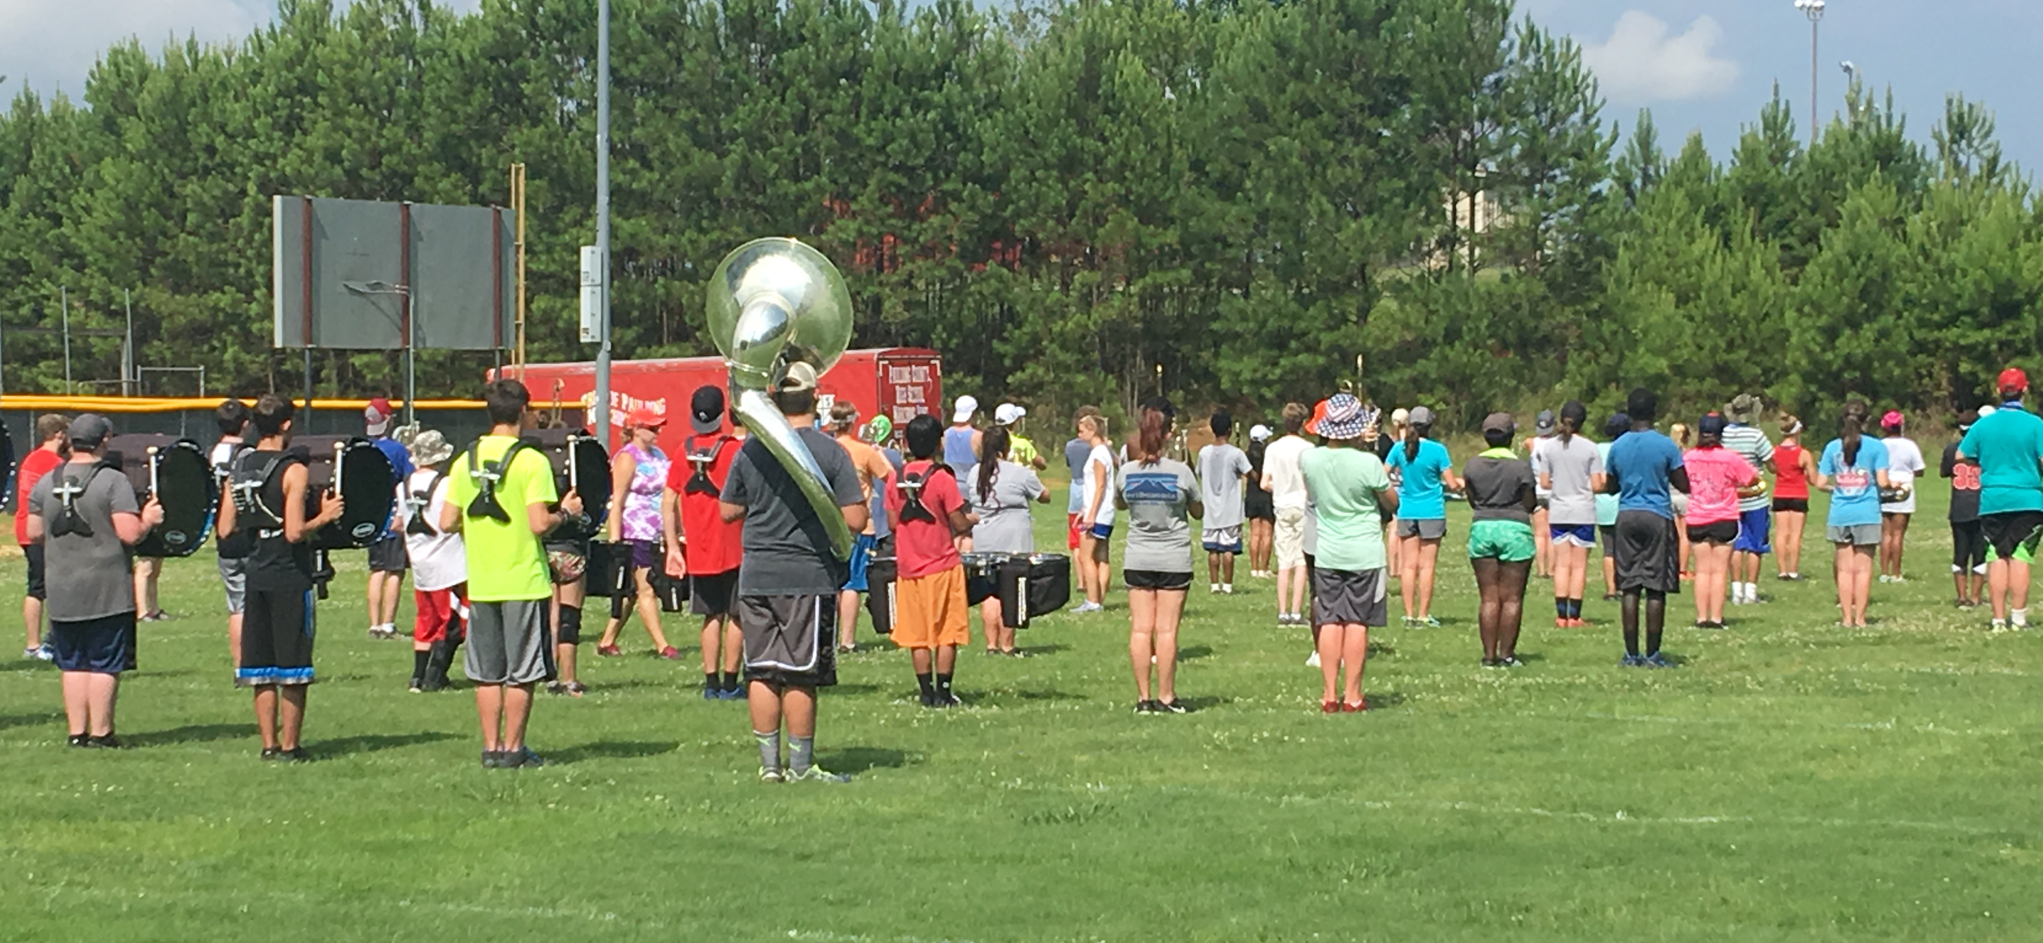
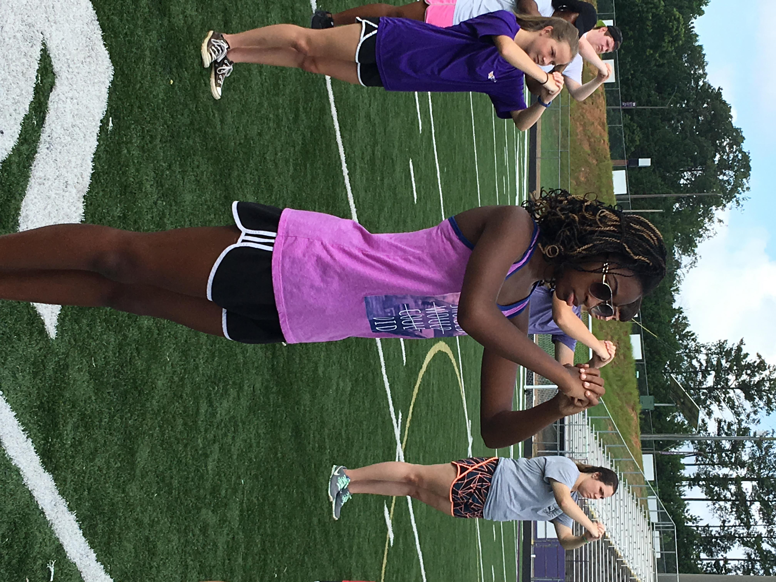
Band Camps – July 10-21
Notes:
Band Camps began at all 5 High Schools on Monday morning, July 10!
It has been VERY HOT and these students and directors have worked VERY HARD – the complaints have been minimal but the attention to detail, dedication, and heart have been completely inspiring.
If you want to surprise one of them, take a trip any day between now and the 21st. Take them a case of Gatorade or Water and make their day.

Slide 15
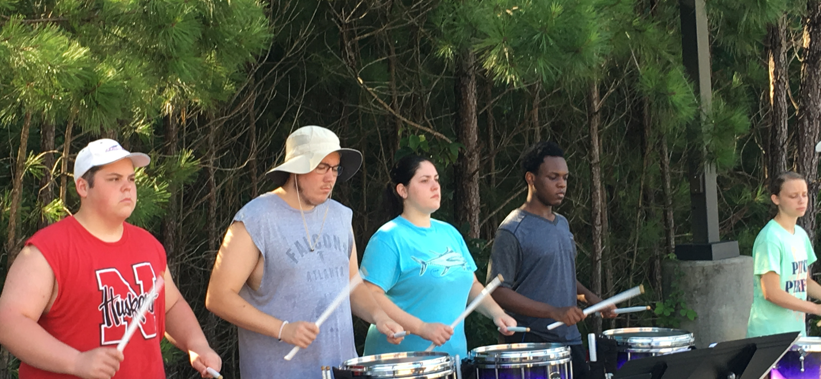
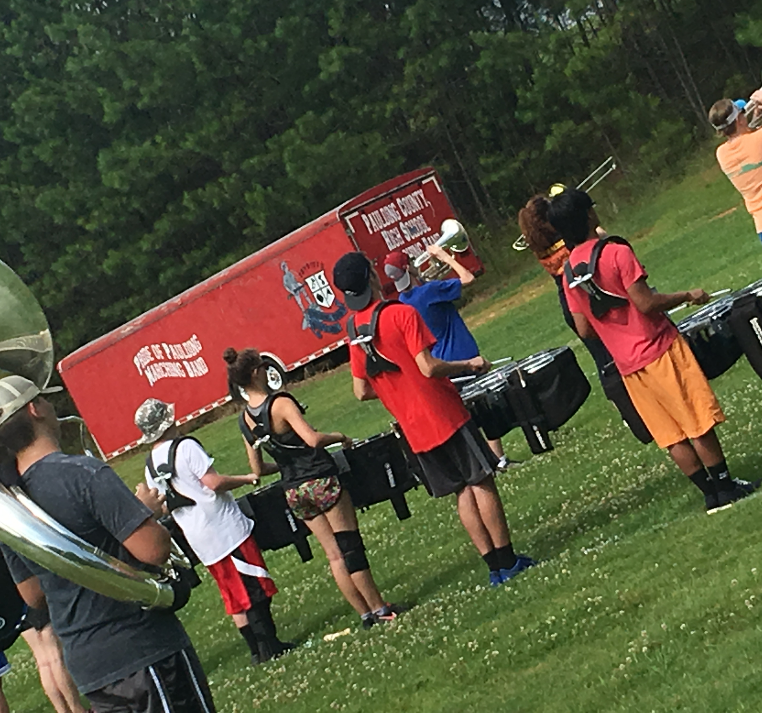
Band CAmp Basics
Notes:
Marching – Music – Focus
Students spend approximately 5 hours of the day Marching! Add to that the fact that they are carrying an instrument and playing music and you have magic.
THIS is physical fitness, coordination, focus, and sheer skill

Slide 16
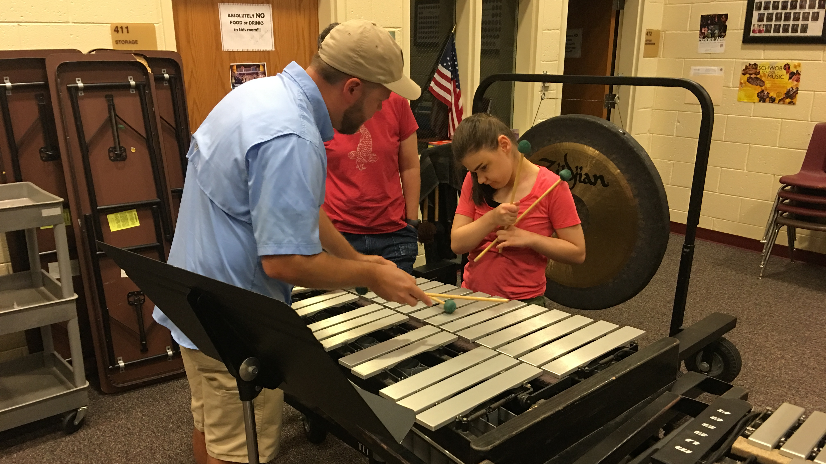
Directors
DJ McConnell – SPHS
Mike Bearden – NPHS
Adrian Gibson – HHS
Aaron Toft – PCHS
Michael Thomas - EPHS
Notes:
These directors and their assistants are ROCK STARS to their students
Some hours for band camps – 8a.m-8p.m.
Hours after school starts – each day until sometimes 7 or later.
They are a family!

Slide 17
Band Dates to remember – community support!
Band Camps
  July 10-14
  July 17-21
PCSD Marching Band Exhibition
  October 16 – hosted by SPHS
PCSD Honor Band
Notes:
Make note of these dates! They are also in your packet!
Come out and support our 5 wonderful band programs!

Slide 18
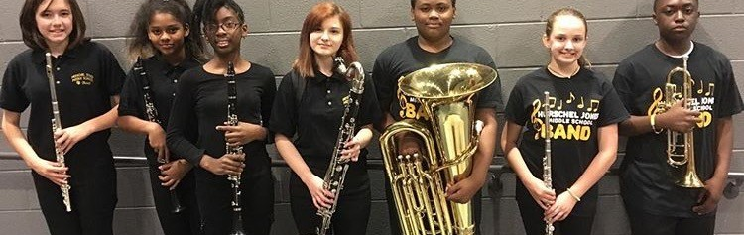
SPLOST dollars at work!
"At Herschel Jones Middle School, approximately 30% of students use an instrument that was purchased with SPLOST dollars. The SPLOST funding allowed us to purchase necessary equipment such as 4 new tubas, 4 new French horns, 3 new trigger trombones and acoustical panels that the HJMS Band Room did not have. SPLOST funding signifigantly helped the quality of our program!" - Mitchell Roberts
Notes:
SPLOST: All of our students are impacted by the instruments and equipment we have been able to purchase through SPLOST. For all of our schools, SPLOST has allowed us to add to and modernize our equipment to meet the needs of our growing band programs. At SPHS, both the band program and the marching band has grown significantly in the past four years. Four years ago, the Marching Band at SPHS was 120 students; this year it is 185. Without the instruments we were able to purchase with SPLOST funds, it would have been impossible to facilitate our growth. SPLOST has allowed us to purchase high quality instruments that continue to enable our students to be successful both inside and outside of the classroom.
Now I will turn it over to our Choral Representative for tonight, Chelsea Rhoades
Chelsea is the Director of Choral Activities at North Paulding High School
For SPHS – at least 50% of our students use a SPLOST funded instrument.

Slide 19
Choral Programs in pcsd
Notes:
Chelsea

Slide 20
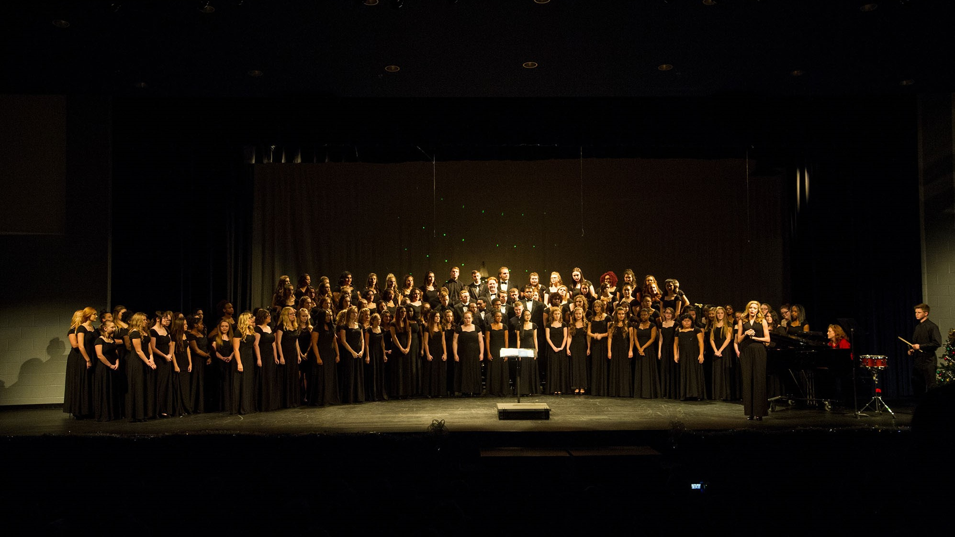
Choral Music in PCSD
In Paulding County choral programs, students obtain discipline, attention to detail, the ability to work in teams, and close social gaps.
Notes:
Chelsea

Slide 21
Choral programs
Paulding Choruses: local school, community, state, and national involvement
  Local school performances, senior home and chamber of commerce performances, Governor's Mansion performance opportunities, and performances in Florida, New York, and Tennessee
Special events this year:
  Hiram/North Paulding mastery choirs present Faure's REQUIEM (performance dates TBA)
  High School Chorus County Honor Choir, featuring special guest clinicians from UWG, KSU, GSU, etc (February 2, 2018)
  6th Grade Spring Sing (March 5, 2018)
  Large Group Performance Evaluations (end of March, TBA)
Important Dates for 2017-2018
Notes:
Chelsea

Slide 22
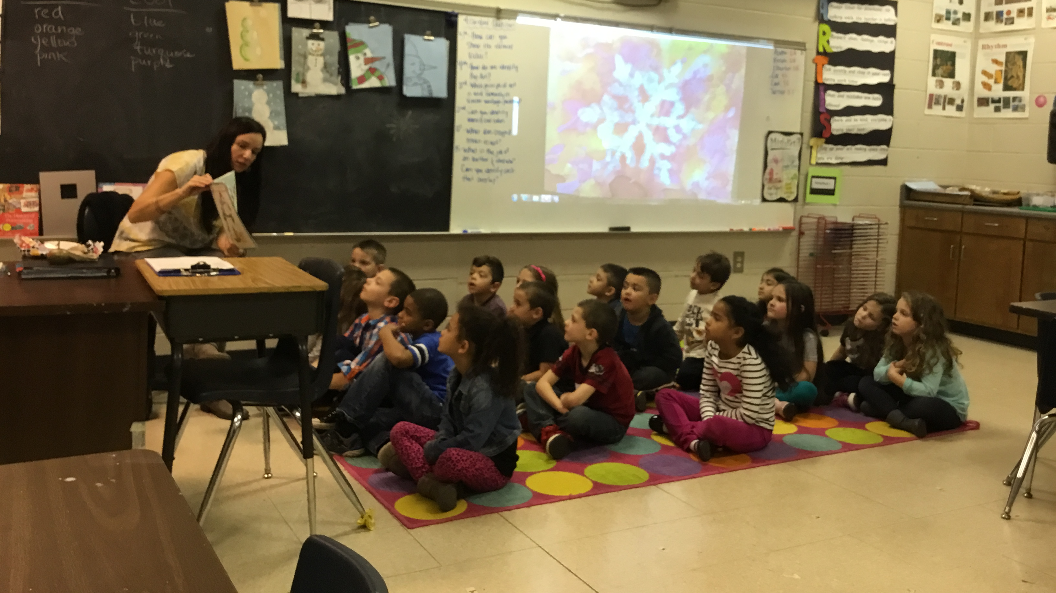
Elementary Fine ARts
Notes:
Katie
Power programs at the high schools that send students into college and career begin right here!
Elementary!

Slide 23
Elementary Music in PCSD
Sing, Move, and Play ~ EVERYDAY
Notes:
Katie will talk about the upcoming standards refresh here
Talking about what has been going on with our first Curriculum Design and what will be going on with the upcoming changes from the state.
Elementary Honor Chorus highlighted here
**Event is held the weekend of March 9-10 with a community concert given on Saturday, March 10 at 5:00p.m. at EPHS theatre.
This is included in your packet!
Curriculum Design Team to be formed after this year

Slide 24

Elementary Music LEadership
Cheryl Walburn, Roberts Elementary
Daniel Gaddis, McGarity Elementary
Katie Matthews, Union Elementary
Becky Miller, Abney Elementary
Karen Emerine, Hutchens Elementary
Kristen Ragan, Northside Elementary
Standards Revision Process - 2017/2018
Research and Design
Professional Development
Peer Mentorship
Advocacy
Lead Elementary Honor Choir Prep
Notes:
Katie
Recognize the Leadership and what they do during the year

Slide 25
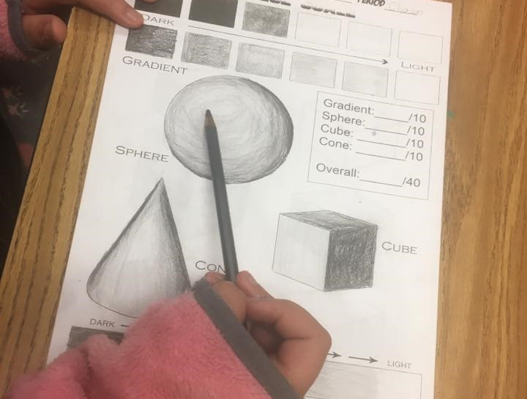
Elementary Art
Notes:
Katie will talk about Elementary Art

Slide 26

Elementary art curriculum design team
Meredith Lowe, Russom Elementary
Julie Bailey, Burnt Hickory Elementary
Rebecca Leitz, Panter Elementary
Sara McKouen, Roberts Elementary
Heather Austin, Hutchens Elementary
Colleen Kibler, Ragsdale Elementary
Standards Revision Process
Research and Design
Professional Development
Peer Mentorship
Advocacy
Notes:
Katie will recognize the Elementary Art Curriculum Design Team
The process has taken a year.
Standards have been completely refreshed from the State Department of Education
New Curriculum Design based on these new standards
Much of our elementary art classrooms will incorporate cross-curricular components. - A lot of Science and Math included! STEAM
Introduce Anne and the breakout time

Slide 27

STEAM
Connection Science, Technology, Engineering, Art, and Mathemathics
Notes:
The Fine Arts are naturally cross curricular!
A Main Component of the new art standards is that students can "Connect art to other subjects" and "Connect Art to MY world"

Slide 28
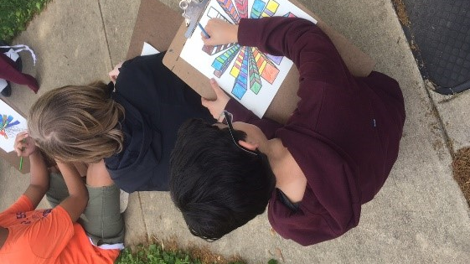
Middle and high school visual art
Notes:
Anne

Slide 29
Middle/High Performance Standards
(2009)
Overview
Middle School (6-8) standards broken down by grade
High School (9-12) standards divided into four subjects
  Visual Comprehensive
  Drawing
  Painting
  Sculpture
Sections of standards (both middle and high)
  Meaning and Creative Thinking
  Contextual Understanding
  Production
  Assessment and Reflection
  Connections
Notes:
Anne

Slide 30
Middle/High Performance Standards
(2009)
Wordy/Lengthy
High School standards limited to four subjects
EXAMPLES:
Middle School (7th) Production
VA7PR.1 Understands and applies media, techniques, and processes with care and craftsmanship.
a. Works directly with materials in a variety of ways (e.g., intuitive, spontaneous, and free, thoughtfully from sketchbook ideas or carefully considered plans).
b. Uses tools and materials with craftsmanship (e.g., with care in a safe and appropriate manner).
c. Explores various techniques/processes as well as the properties of art materialsim preparation for art making (e.g., drawing, painting, mixed- media, printmaking, sculpture, digital art, fiber arts, ceramics, photography, technology based art works, graphic design).
d. Develops a variety of skills in drawing (e.g., observational, illusion of form, tonal rendering, perspective) to convey meaning and idea.
e. Produces original two-dimensional artworks for intended purpose, using a variety of media (e.g., pencils, markers, pastels, water-based paints, printmaking materials, photographic/electronic media). f. Uses technology to produce original works of art (e.g., digital photo montage on a personally or socially compelling theme).
g. Produces works of art that demonstrate knowledge of various styles of art (realism, formalism, abstraction).
h. Understands and practices safe and appropriate handling of art materials and tools.
Notes:
Anne

Slide 31
Middle/High Performance Standards
(2009)
Wordy/Lengthy
High School standards limited to four subjects
EXAMPLES:
High School (9-12) Meaning and Creative Thinking
VAHSVAMC.3 Cultivates critical thinking and logical argumentation in aesthetics.
a. Discusses aesthetic issues, such as what is beauty? What affects my personal aesthetic?
b. Writes, reflects, and revises throughout the course a personal answer to the question, what is art?
c. Identifies the ideas and values reflected in the art of past and present cultures.
d. Explores ideas and values reflected in the way the student’s current culture(s) define and use art.
e. Researches and analyzes the work of an artist and writes about how the artist’s style contributes to the meaning of the work.
Notes:
Anne

Slide 32
Middle/High GA Standards of Excellence
(2017)
Aligned with current National Visual Art Standards
Condensed Wording
Sections of Standards (both middle and high)
  Creating Presenting
  Responding Connecting
High School Standards specific to a broader range of subjects
Applied Design
Art History
Ceramics
Digital Design
Fashion Design
Fibers
Graphics
Jewelry and Metalcrafts
Painting
Photography
Printmaking
Sculpture
Video and Filmmaking
Visual Art Comprehensive
Notes:
Anne

Slide 33
Middle/High GA Standards of Excellence
(2017)
Visual Arts Crosswalk
Performance Standard | Standard of Excellence
VA7PR.1 Understands and applies media, techniques, and processes with care and craftsmanship. | Reorganized/combined into VA7.CR.3, VA7.CR.2, and VA7.CR.4
VAHSVAMC.3 Cultivates critical thinking and logical argumentation in aesthetics. | Reorganized/combined into VAHSVA.CR.1
Examples of GA Standards of Excellence
VA7.CR.3 Engage in an array of processes, media, techniques, and/or technology through experimentation, practice, and persistence.
a. Demonstrate a variety of skills and techniques for 2D and 3D works of art.
b. Demonstrate quality craftsmanship through proper care and use of tools, materials, and equipment.
c. Utilize and care for materials, tools, and equipment in a safe and appropriate manner.
VAHSVA.CR.1 Visualize and generate ideas for creating works of art.
a. Generate and conceptualize artistic ideas and work.
b. Consider multiple options, weighing consequences, and assessing results.
c. Practice the artistic process by researching, brainstorming, and planning to create works of art.
13 GA Standards of Excellence (both middle and high) vs. 17/20 Performance Standards (middle/high)
Notes:
Anne

Slide 34
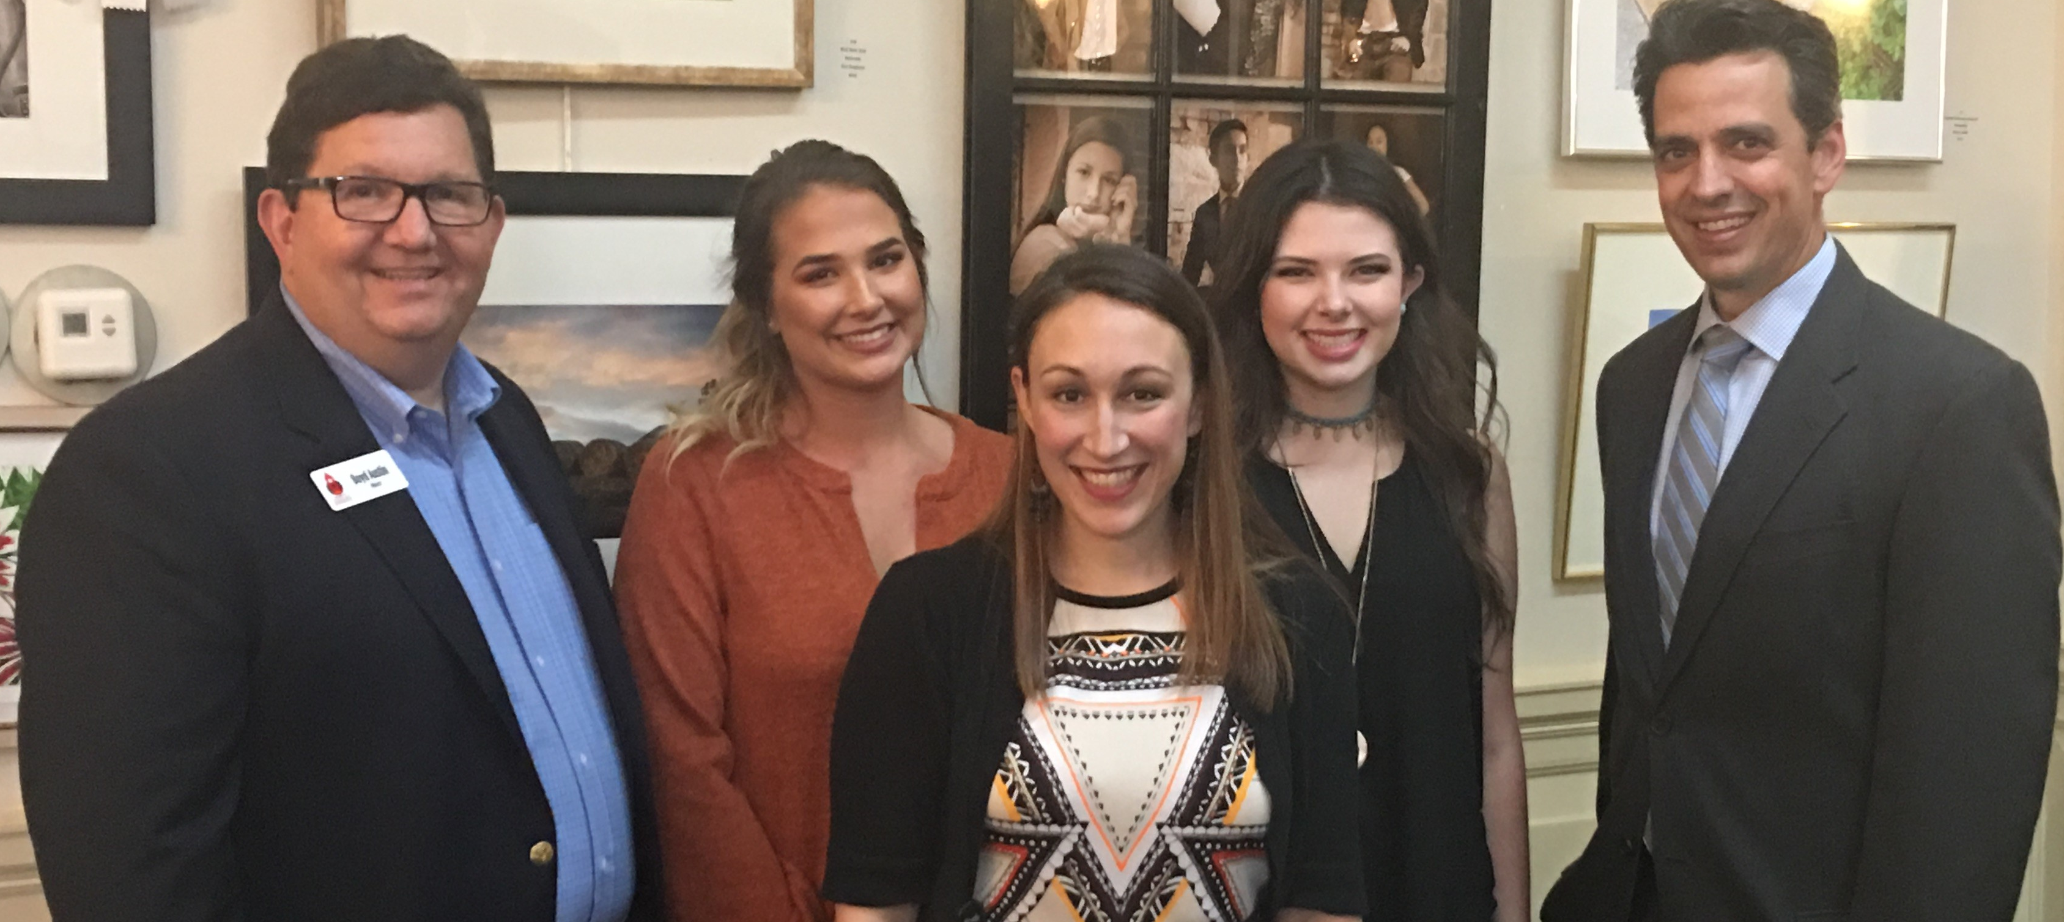
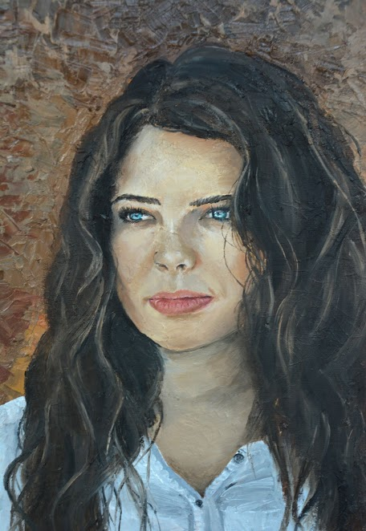
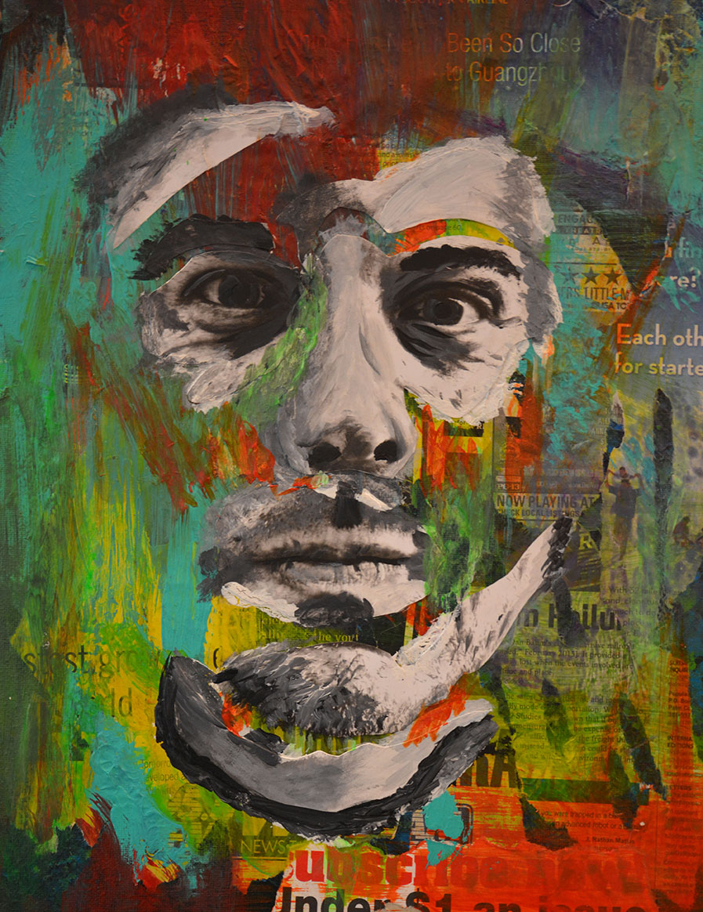
Building a tradition of excellence
14th Congressional District Winners
Morgan Minter, "Madison,"
Oil on Canvas
3rd Place Finish
Madison Moats, "Michael,"
Mixed Media
Honorable Mention (5th place)
Notes:
Anne – please explain this competition and what that means for these students

Slide 35
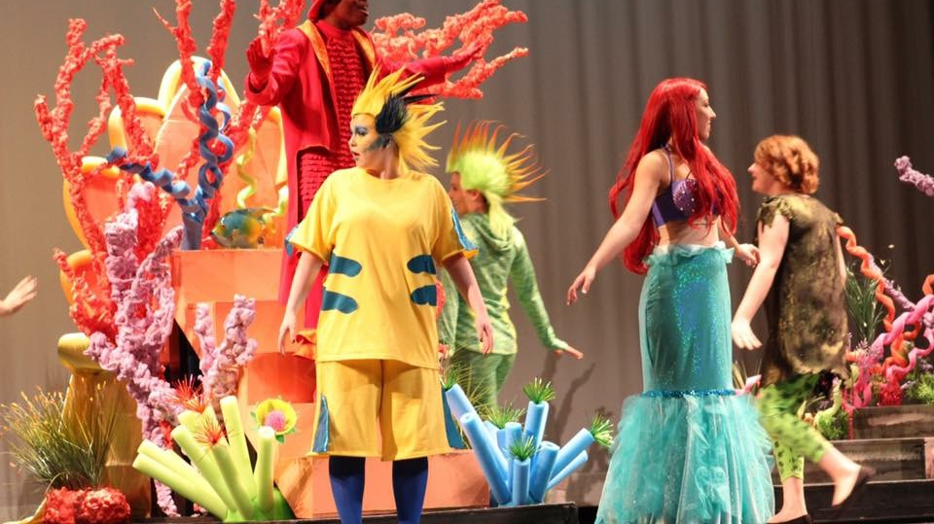
Theatre Arts in PCSD
Creating Culture and Constructing Arts Communities
Notes:
Every year, we have multiple theatrical performances at each school.
In the fall, there are One-Act performances and the One-Act Competition
In the Spring, students attend ThesCon and each school puts on a Musical

Slide 36
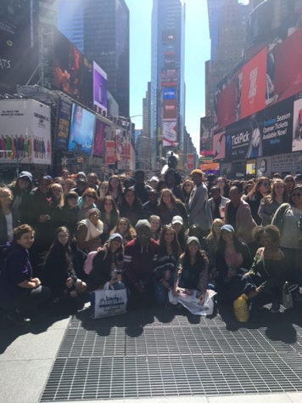
Drama in Paulding
Approximately 1000 students participate
Eight Musicals
  Full-Length and Junior Versions
Three productions submitted to the GA High School Musical Theatre Awards Adjudication Panel
Five GHSA One-Act Plays; 1st & 2nd place in GHSA One Act Competition
Multiple Children's Theatre pieces performed for PCSD Elementary Students
Over 50,000 audience members for 2016-2017 productions!
Trips to NYC for performance workshop intensives

Slide 37
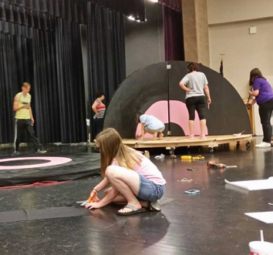
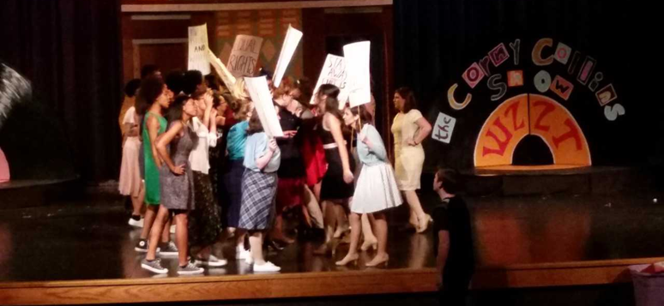
From Rehearsal to Production
Notes:
Theatre at the High School Level is a very rewarding experience and one that opens doors for students interested in a future in the theatre arts
ttp://www.esenetworks.com/custom.aspx?id=15424&menu=110062

Slide 38
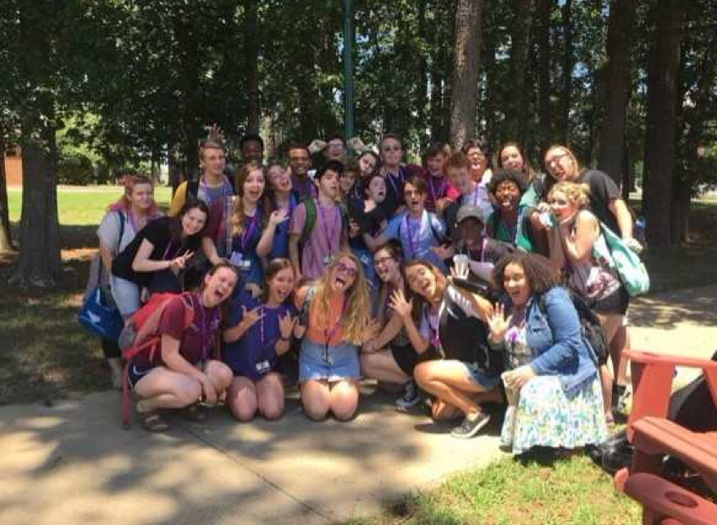
Governor's Honors Program
Three Paulding County students for 2017 ~ Berry College!
Notes:
Three of our students earned placement with the Governor's Honors Program for 2017 at Berry College.
They spent the majority of their summer in intensive workshops and trainings

Slide 39
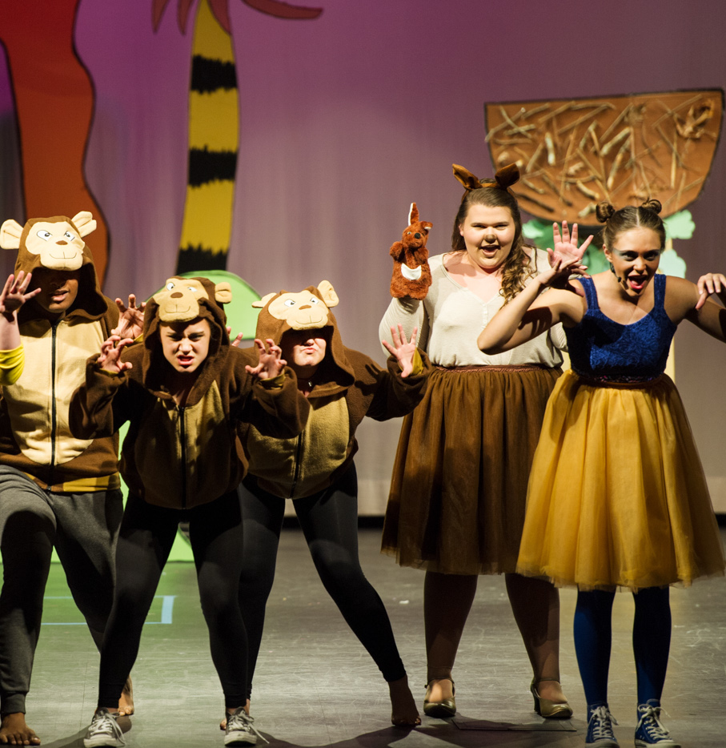
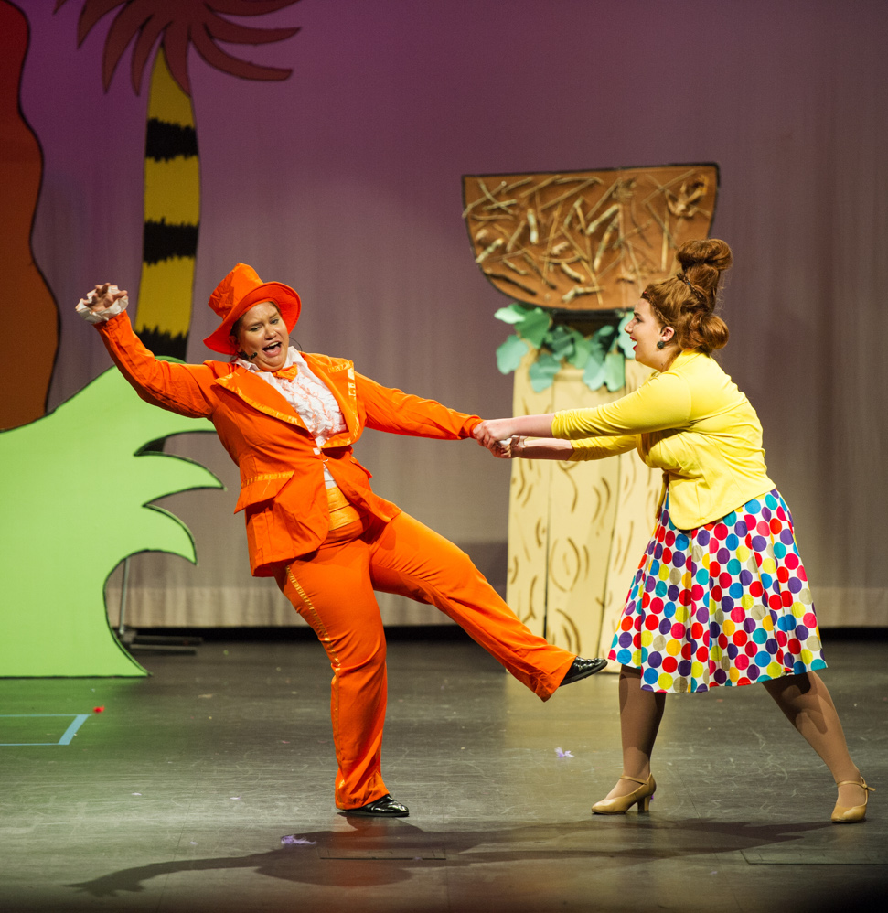
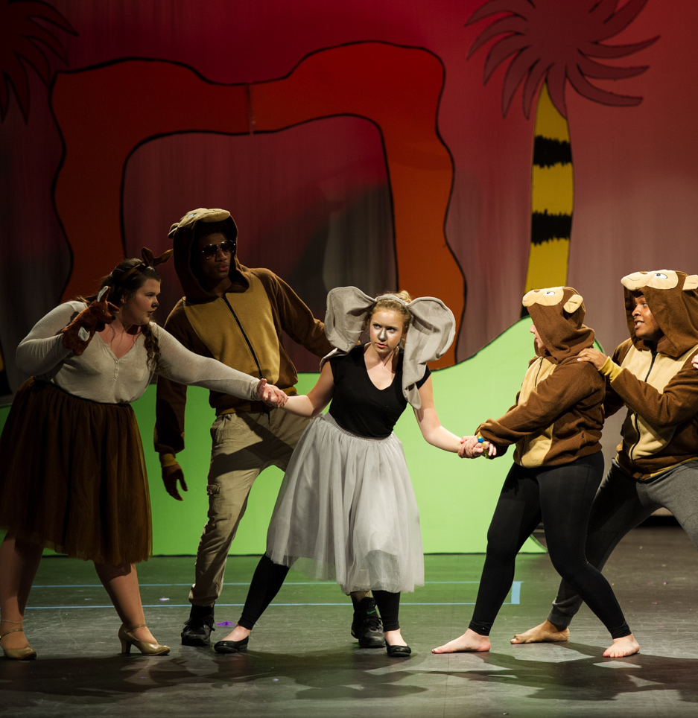
Seussical, jr. Presented by nphs
Kindergarten students from BHES visited NPHS for a performance of Seussical, Jr.
Notes:
Many of our schools perform for the elementary students – This year, NPHS did Seussical Jr.
It is wonderful for our younger students to be able to see quality performances right in our own community and at the school they will one day attend!
It is equally wonderful for older students to offer mentoring to younger students.

Slide 40
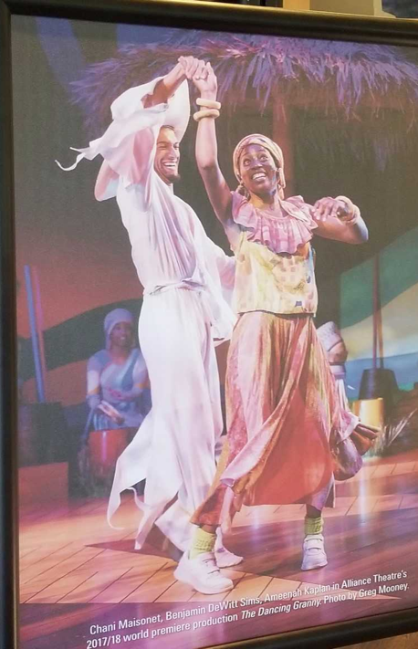
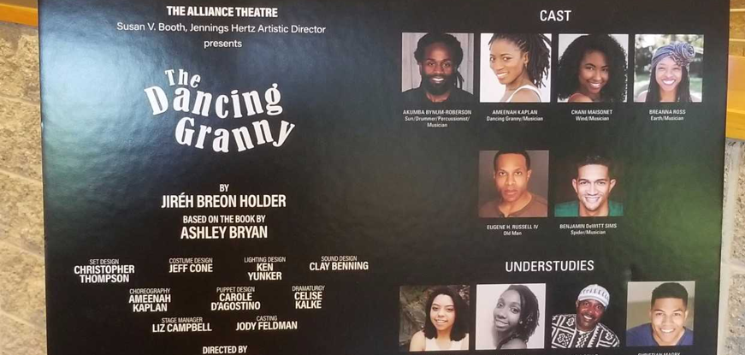
Post-SEcondary Work
Notes:
Ben Simms
Graduate of HHS (2011) and Young Harris College (2015)
Currently working with the Tony-Award winning Alliance Theatre in Atlanta.

Slide 41

The Dancing Granny – Ben Simms (Hiram, class of 2011)

